Slide 1
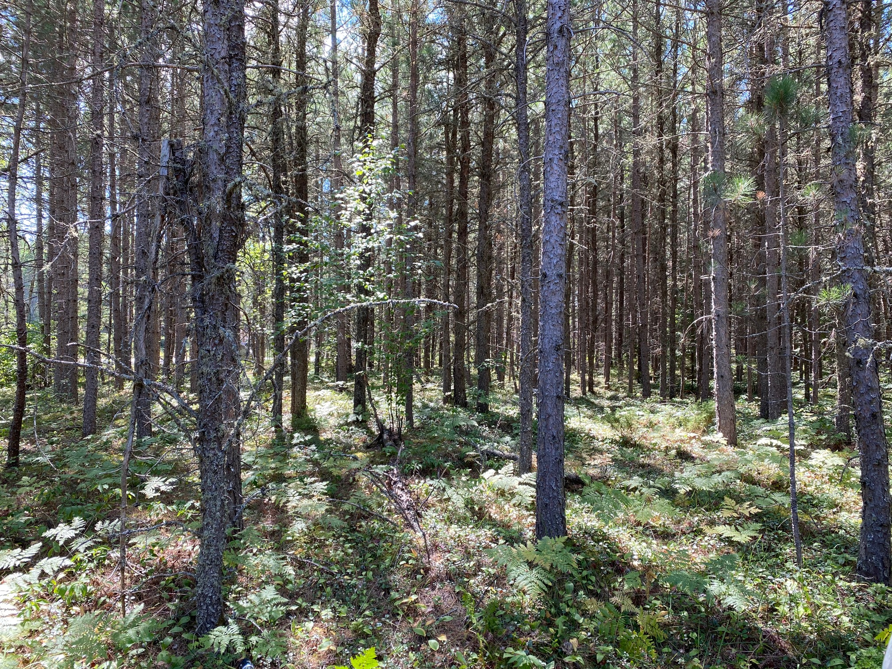
Miisun
2026-2027 Spring Training

Slide 2
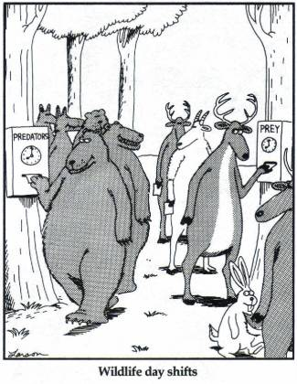
SFM Awareness Training

Slide 3
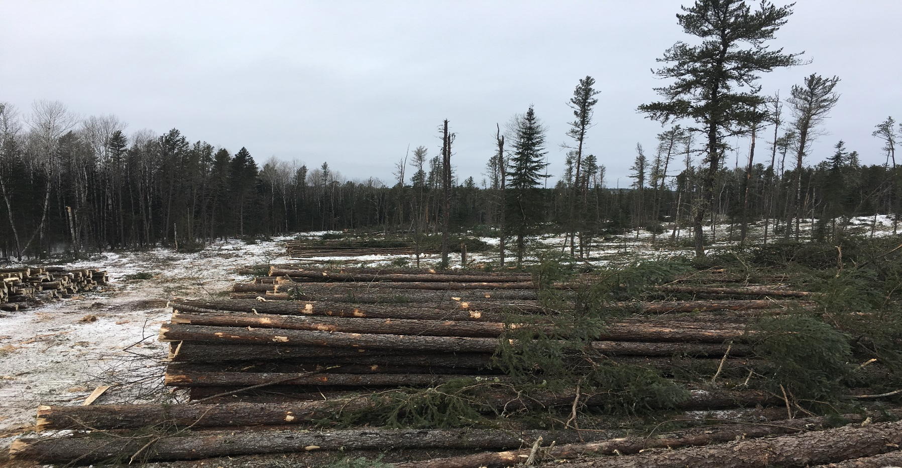
What is SFM Certification?
Sustainable Forest Management (SFM) Certification is a tool to demonstrate to the public that an organization implements responsible forest management practices that consider environmental, social and economic values that are third party audited.

Slide 4



SFM Certification in Canada
Canada has the largest area of third party certified forests in the world (38% of the world’s certified forest area.)
Legal requirement to be SFM certified in Ontario.
Ontario requires License Holders to be certified to one of three standards covering forestry activities:
  SUSTAINABLE FORESTRY INITIATIVE®
  Canadian Standards Association (CSA)
  Forest Stewardship Council (FSC)

Slide 5
  SUSTAINABLE FORESTRY INITIATIVE®
Internationally recognized performance standard aimed at achieving sustainable forest management.
Comprehensive system of principles, objectives and performance measures.
Built to achieve and promote sustainable forest management on all forestlands.

Slide 6
Forest Stewardship Council (FSC)
International certification scheme.
Participants must meet the common core principles and criteria for their Forest Management Standard.
In addition, must meet the principles and criteria in one of the four regional standards appropriate for their area. They are:
  National Boreal,
  British Columbia,
  Great Lakes, St. Lawrence, Laurentian,
  Maritimes.

Slide 7
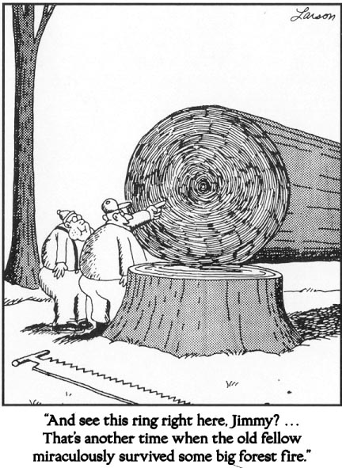
Three SFM systems in Canada
Which Standard is the Kenora Forest Certified to?
How do they measure our performance to the SFI Standard?

Slide 8
SFI Certification, and why...
Introduction
Why is this critical to our Kenora operations?
  Improve forest stewardship
  Market awareness and pressure
  Customers are demanding it, thus facilities are demanding it.
  Support from CCSIC and SFI
  Ensure legal compliance
  Consider the alternative ?

Slide 9
Two Tiers of our
Environmental Certification
Introduction
(1) SFI
  SFI = Sustainable Forestry Initiative Certification
  Based on the premise that responsible environmental behavior and sound business decisions can co-exist.
  SFI Program participants practice sustainable forestry on all lands they directly manage.
  SFI Program participants also influence millions of hectares through the training of loggers and foresters in best management practices and landowner outreach programs on private land.
(2) EMS
  EMS = Environmental Management System
  What makes up our EMS? Spring training, pre-works, values reporting, compliance monitoring, erosion control, reference cards, fuel tank audits, MNR communication, and 100 other things.
  We maintain our SFI certification by following our EMS (using the systems)
  Continual improvement is the key component
  of all our environmental requirements!

Slide 10
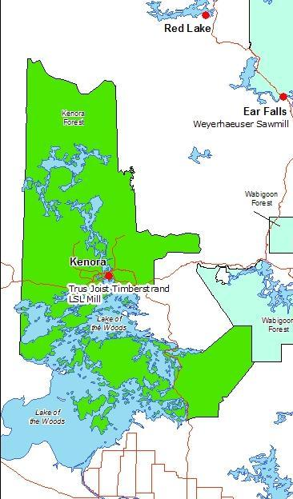
Certification
Introduction
Where does this certification apply?
  The Kenora Forest (Kenora Sustainable Licence (SFL)).

Slide 11

Central Canada SFI Implementation Committee (CCSIC)
Local SFI Implementation Committees are key to promoting the SFI Program.
In Ontario and Manitoba, the SFI Program is overseen by the Central Canada SFI Implementation Committee (CCSIC).
CCSIC was formed in December 2003.
Members include SFI Program Participants and supporters.
Notes:
The EMS will implement the strategies contained in the Environmental Policy
The key points of the policy include
comply with all laws and EMS requirements
Practice Sustainable Forestry (protect air, water, soil, wildlife, people)
Conserve natural resources through minimizing waste and recycling
prevent pollution by packing out the garbage and taking it to the landfill, or recycling facility.
All these points are contained on the yellow card that is to be placed in the equipment and the operator can refer to it all times
The card provides helpful points on what you need to know when interviewed by an auditor.

Slide 12
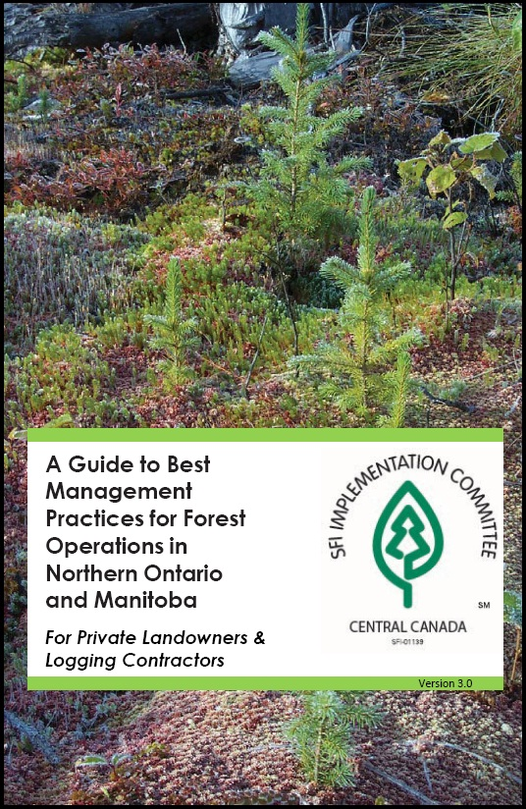
CCSIC Functions
Supports and encourages Landowners to apply the principles of Sustainable Forest Management on their lands,
Encourage Landowners and Land Managers to harvest and reforest their lands using Best Management Practices by providing information on SFM,
Develop and promote mechanisms for public outreach, education, and involvement relating to Forest Management,
Develop and co-ordinate training programs for Qualified Logging Professionals

Slide 13
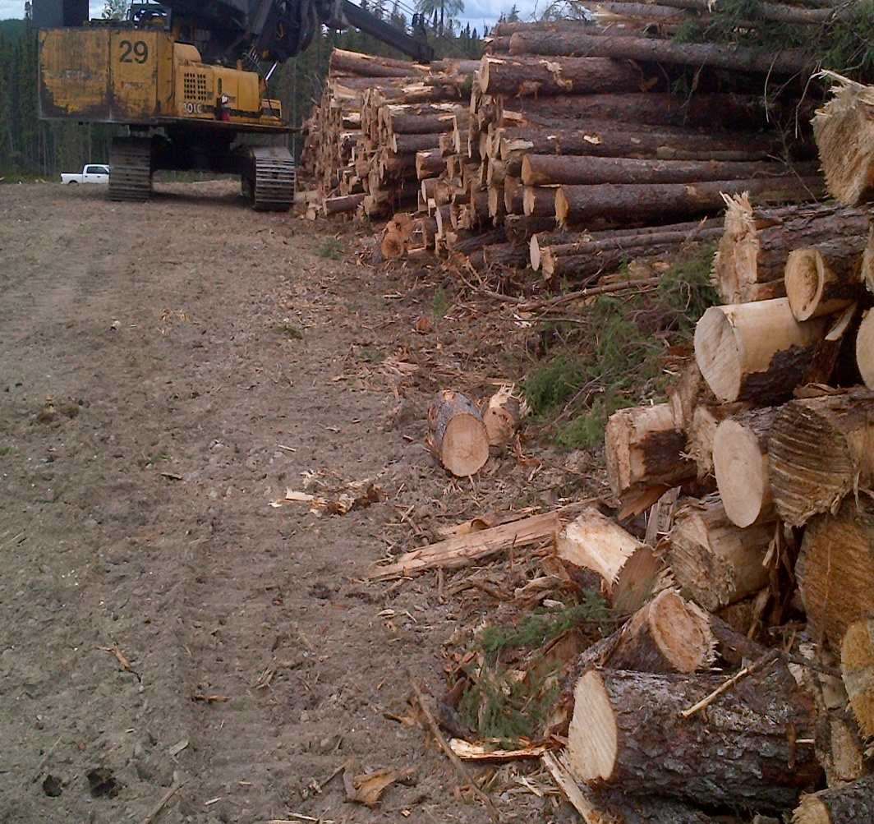
Inconsistent Practices
What are inconsistent Practices?
Activities conduced by SFI Program Participants that are not consistent with the SFI Standard
Determine if complaint requires an investigation and provides a credible response to the complainant.
Complaints tracked annually and submitted to SFI Inc.

Slide 14
Inconsistent Practices
CCSIC Inconsistent Practices Coordinators:
Chris Bodnar and Steve Young
For more info on CCSIC visit www.sficentralcanada.org

Slide 15

Qualified Logging Professional
A Qualified Logging Professional (QLP) is a person with specialized skills in timber harvesting gained through experience or formal training who has successfully completed wood producer training programs recognized by the Central Canada SFI Implementation Committee (CCSIC).

Slide 16
QLP Requirements – 3 parts:
Legal
MHEO Common Core
WHMIS
Environmental
EMS Training
SARs and Invasive Sp.
SFI Awareness
Certification Awareness
Continuing Education
First Aid*
TDG*
*if required
QLP?

Slide 17
Species at Risk
Species at Risk will fall into four Categories:
Special Concern
Threatened
Endangered
Extirpated
Your Responsibility?:
Know what SARs inhabit the Kenora Forest,
Know the habitat requirements,
Treat nests & dens as values. STOP WORK!
REPORT – To Supervisor, Missun or MNRF
Review the Kenora Forest SARs Index Card.

Slide 18
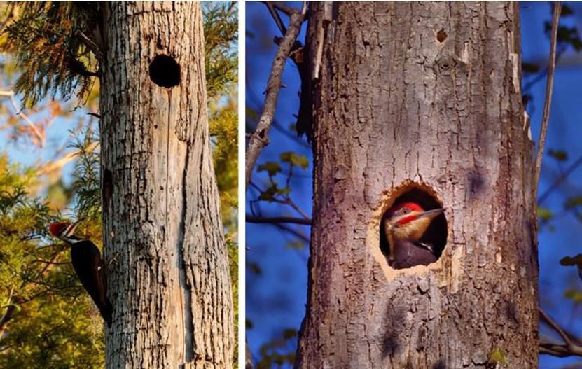
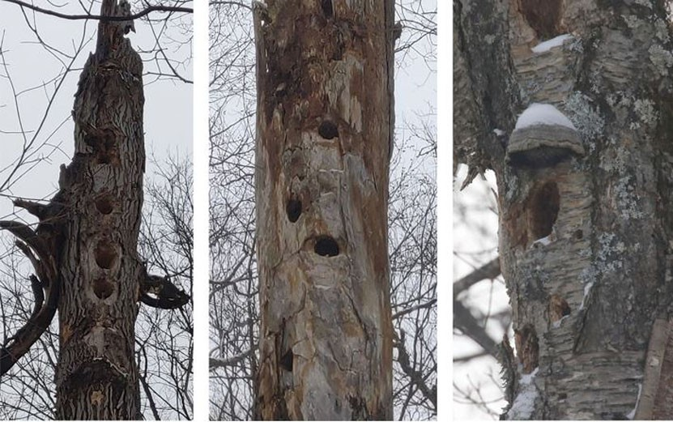
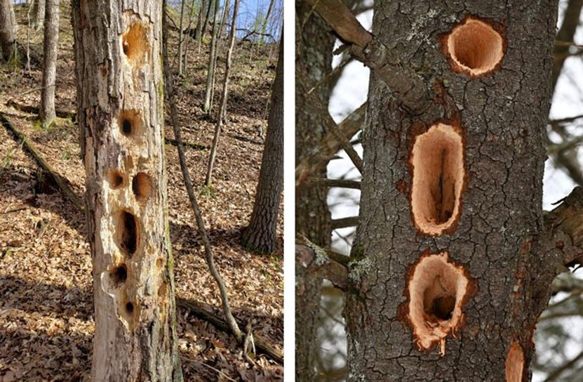
Species at Risk / Migratory Birds
Black Ash:
Can’t be taken to mill
Avoid cutting if possible
  Leave for wildlife trees
  Avoid entire area
If cut for roadline:
  Leave at roadside / in block
  Use for corduroy
  Fuelwood (can’t leave province)
Pileated Woodpecker:
Leave all cavity trees standing

Slide 19
Invasive Species
Invasive Exotic Plants & Animals – Species introduced from another country or geographic region outside its natural range that may have fewer natural population controls in the new environment (SFI Def.)
Your Responsibility?:
Know your Invasive Species in your area,
Limit the introduction, impact & spread of Invasive Species,
Co-operate with other agencies in their efforts/programs,
Review your card periodically and report sightings!
Review the Invasive Species List.

Slide 20

Your Environmental
Management System

Slide 21
EMS
Our Environmental Management System (EMS) is designed to meet the standards of the Sustainable Forestry Initiative® (SFI®) 2022 Forest Management (FM) Standard.
The procedures and requirements with our EMS are the means of maintaining our SFI Certification (i.e. SOP’s, Pre-Works, Reference Cards, Species at Risk cards, Fuel Tank Requirements, Training Requirement and Record Keeping, etc.)
Notes:
EMS standardizes how jobs are performed to reduce the impact on the environment

Slide 22

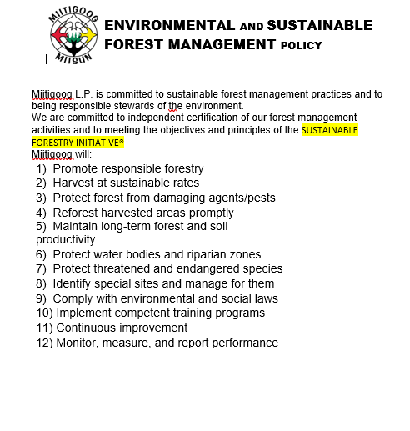
Miitigoog EMS and SFM Policy
Notes:
The EMS will implement the strategies contained in the Environmental Policy
The key points of the policy include
comply with all laws and EMS requirements
Practice Sustainable Forestry (protect air, water, soil, wildlife, people)
Conserve natural resources through minimizing waste and recycling
prevent pollution by packing out the garbage and taking it to the landfill, or recycling facility.
All these points are contained on the yellow card that is to be placed in the equipment and the operator can refer to it all times
The card provides helpful points on what you need to know when interviewed by an auditor.

Slide 23
Reporting
Report environmental incidents to your supervisor or a Miisun manager.
An Environmental Incident may include:
  Hazards such as roads washing out, culvert backed up
  Any Spills, wasteful practices, soil or water damage
  Laws being broken (Cut infraction/trespass, inadequate snags left, push piles in bush line, )
SFI Certification requires that operations continuously improve their performance and systems. Reporting incidents allows the opportunity to determine causes, and prevent them from reoccurring.

Slide 24


Slide 25
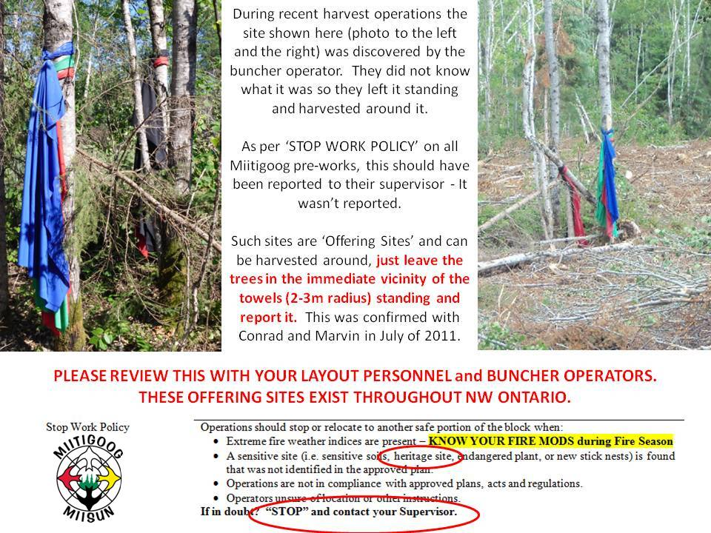

Slide 26
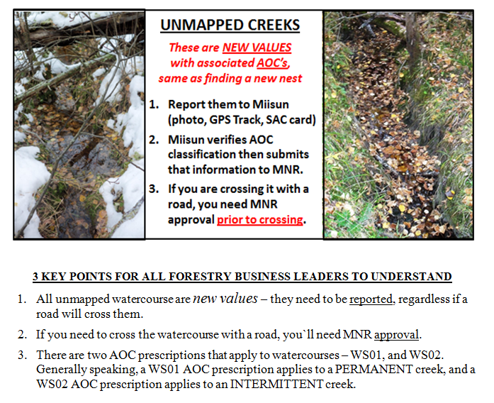
Unmapped Creeks
ON EVERY
PRE-WORK.

Slide 27
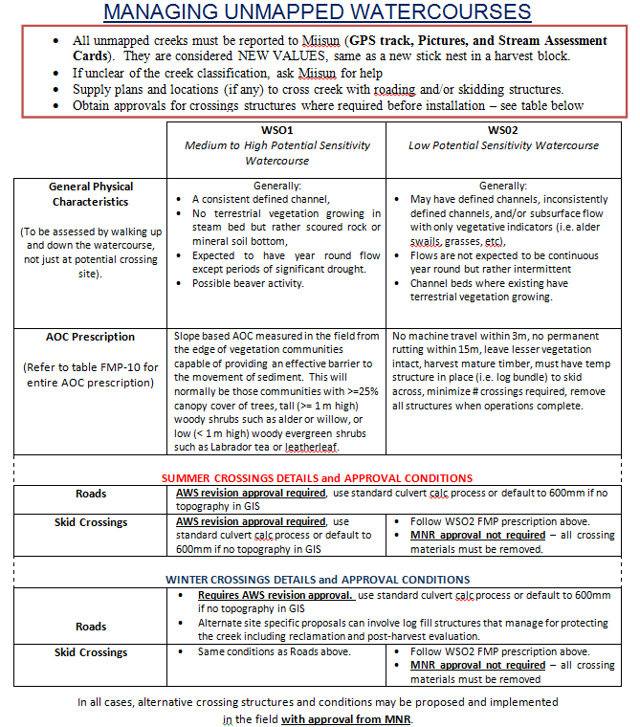
From Watercourse Crossing S.O.P.
Notes:
Report safety incidents to your supervisor or a Weyerhaeuser rep. - report any accidents where there was medical attention, lost time, or near misses.
Report all environmental incidents to your supervisor or Weyerhaeuser rep. -
An Environmental Incident may include:
roads washing out,
laws being broken - such as timber trespass, culverts not installed during work window,
EMS procedures not followed - such as blocks not being ribboned, spills >25L, and
Areas for improvement (near misses) - procedures can be re-written to make wording clearer, need to add or change procedures .

Slide 28
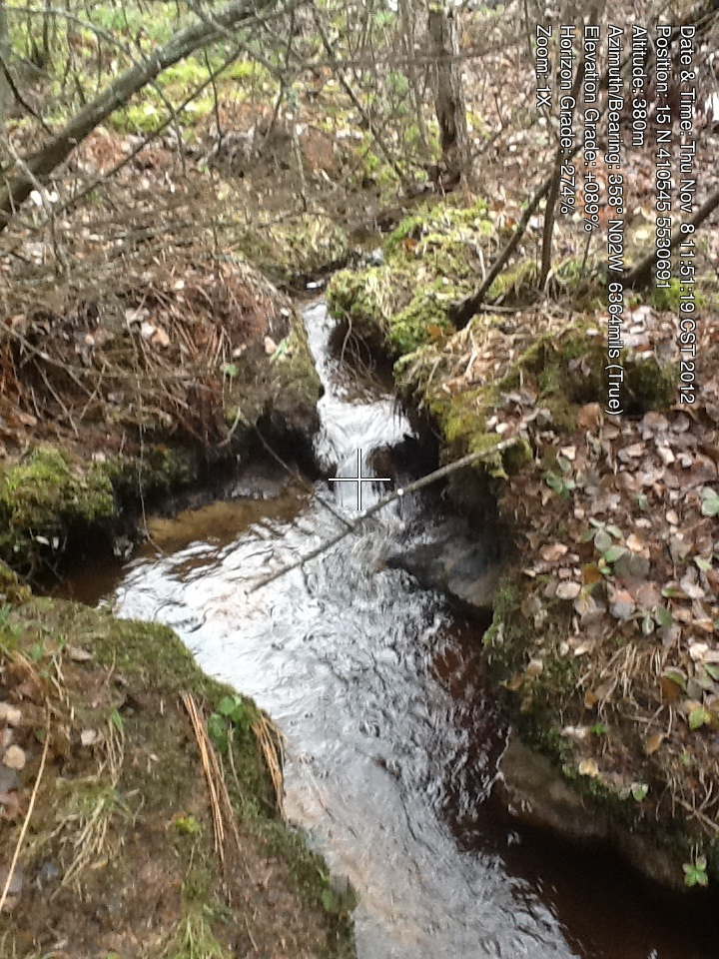
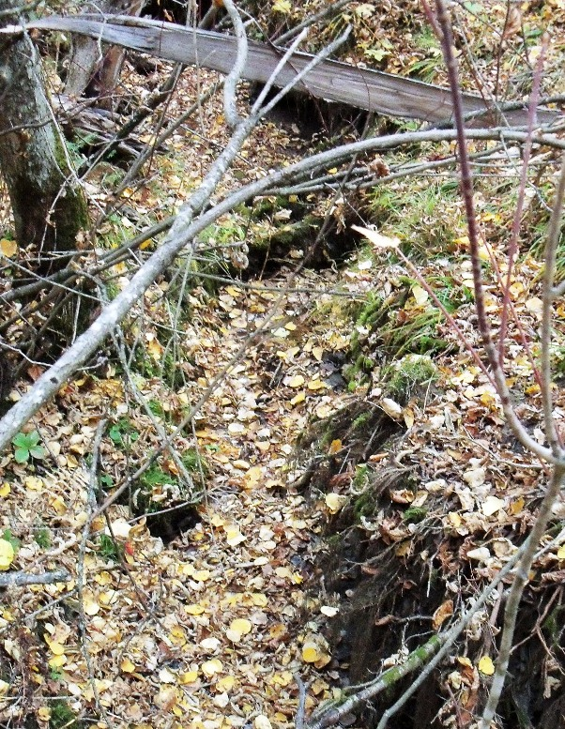
Classifying Unmapped Creeks
Permanent Creeks (WS01 AOC)
ALWAYS nothing growing in streambed
Streambed usually shows rock or washed coarse sand
Usually a well defined channel
Usually year round flow
Beaver dams a good indicator
Can be narrow – don’t be deceived by size
Usually linked with topo lines
Intermittent Creeks (WS02 AOC)
ALWAYS something growing in streambed somewhere
Streambed is usually dark organic, leaf pack, green shoots growing
Inconsistent or no channel
Shorter in length, can disappear and reappear with togography
Usually carry water in spring, early summer, and after rainfalls
Not usually linked to topo lines

Slide 29
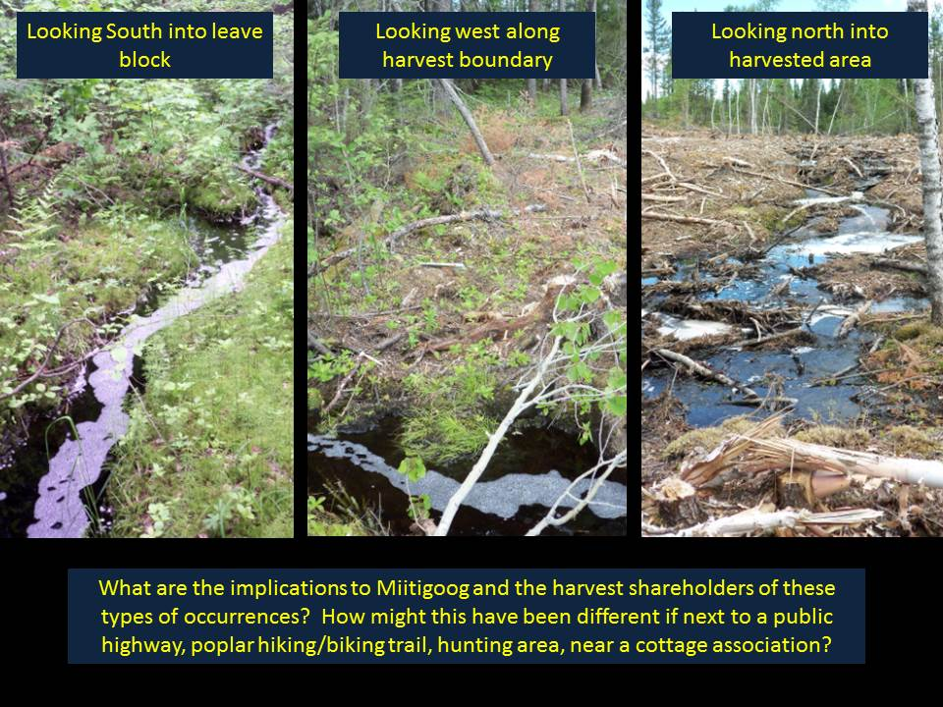
Unmapped Creeks

Slide 30
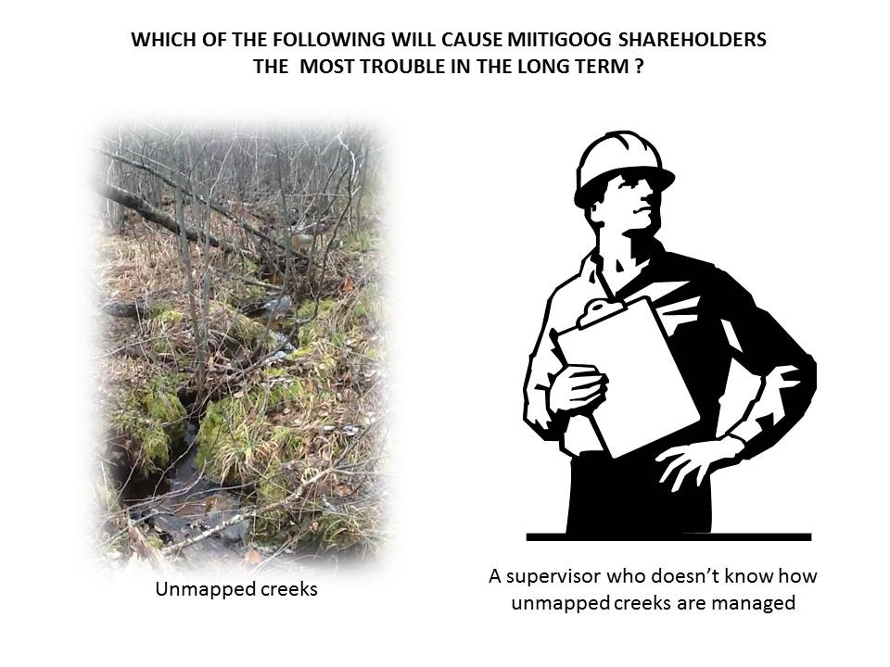

Slide 31

Stop Work
Operations should STOP or relocate to another portion of the block and notify a Miisun representative when:
It’s Unsafe to do the job.
Extreme fire weather indices are present (Fire Mods)
A sensitive site is found (cultural heritage site, stick nest, den, species at risk, unmapped creek, etc) that was not identified in the approved plan or Pre-work.
Operations are not in compliance with approved plans, acts, regulations.
Operators unsure of their location or other instructions
Following a recent heavy rainfall event… WHY?

Slide 32
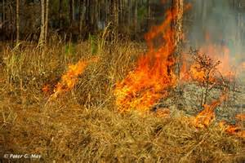
Emergency Preparedness for Fires
If safe - attempt to contain fire
Report fire to supervisor / Miisun
If unable to contact anyone report to MNR
Stay with fire until relieved
Have fire equipment on site and in functional condition (Check daily - water packs full and sufficient tools)
Know where the main fire cache and equipment is kept on a daily basis.
Know the emergency evacuation plan for the block?
Participate in forest fire refresher training SP-102
Know /”Own” the Fire Mods System – everyone in an operation should know who owns this for the business – it can’t be half managed

Slide 33
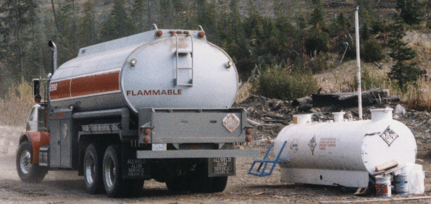
Fuel Storage and Transportation – where is this from? What is wrong with it?

Slide 34
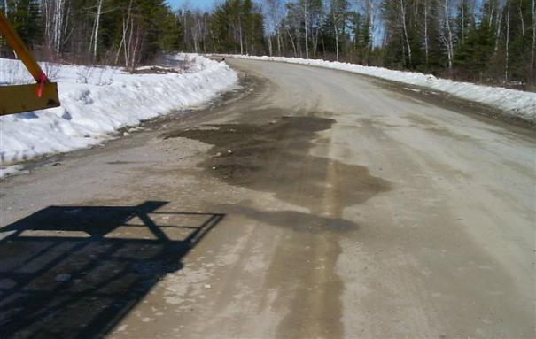
Emergency Preparedness for Spills
Ensure area is .
the source of damage.
damage using spill kit or dirt.
damage to your supervisor.
according to the directions of your supervisor.
SAFE
STOP
CONTAIN
REPORT
CLEAN-UP & DISPOSE

Slide 35
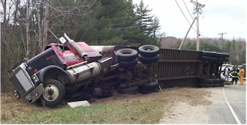
Reporting Spills
Report all spills to your supervisor if :
    > 25 liters on the ground
    1 litre in the water
    Reporting Limits are on your EMS Reference Card

Slide 36
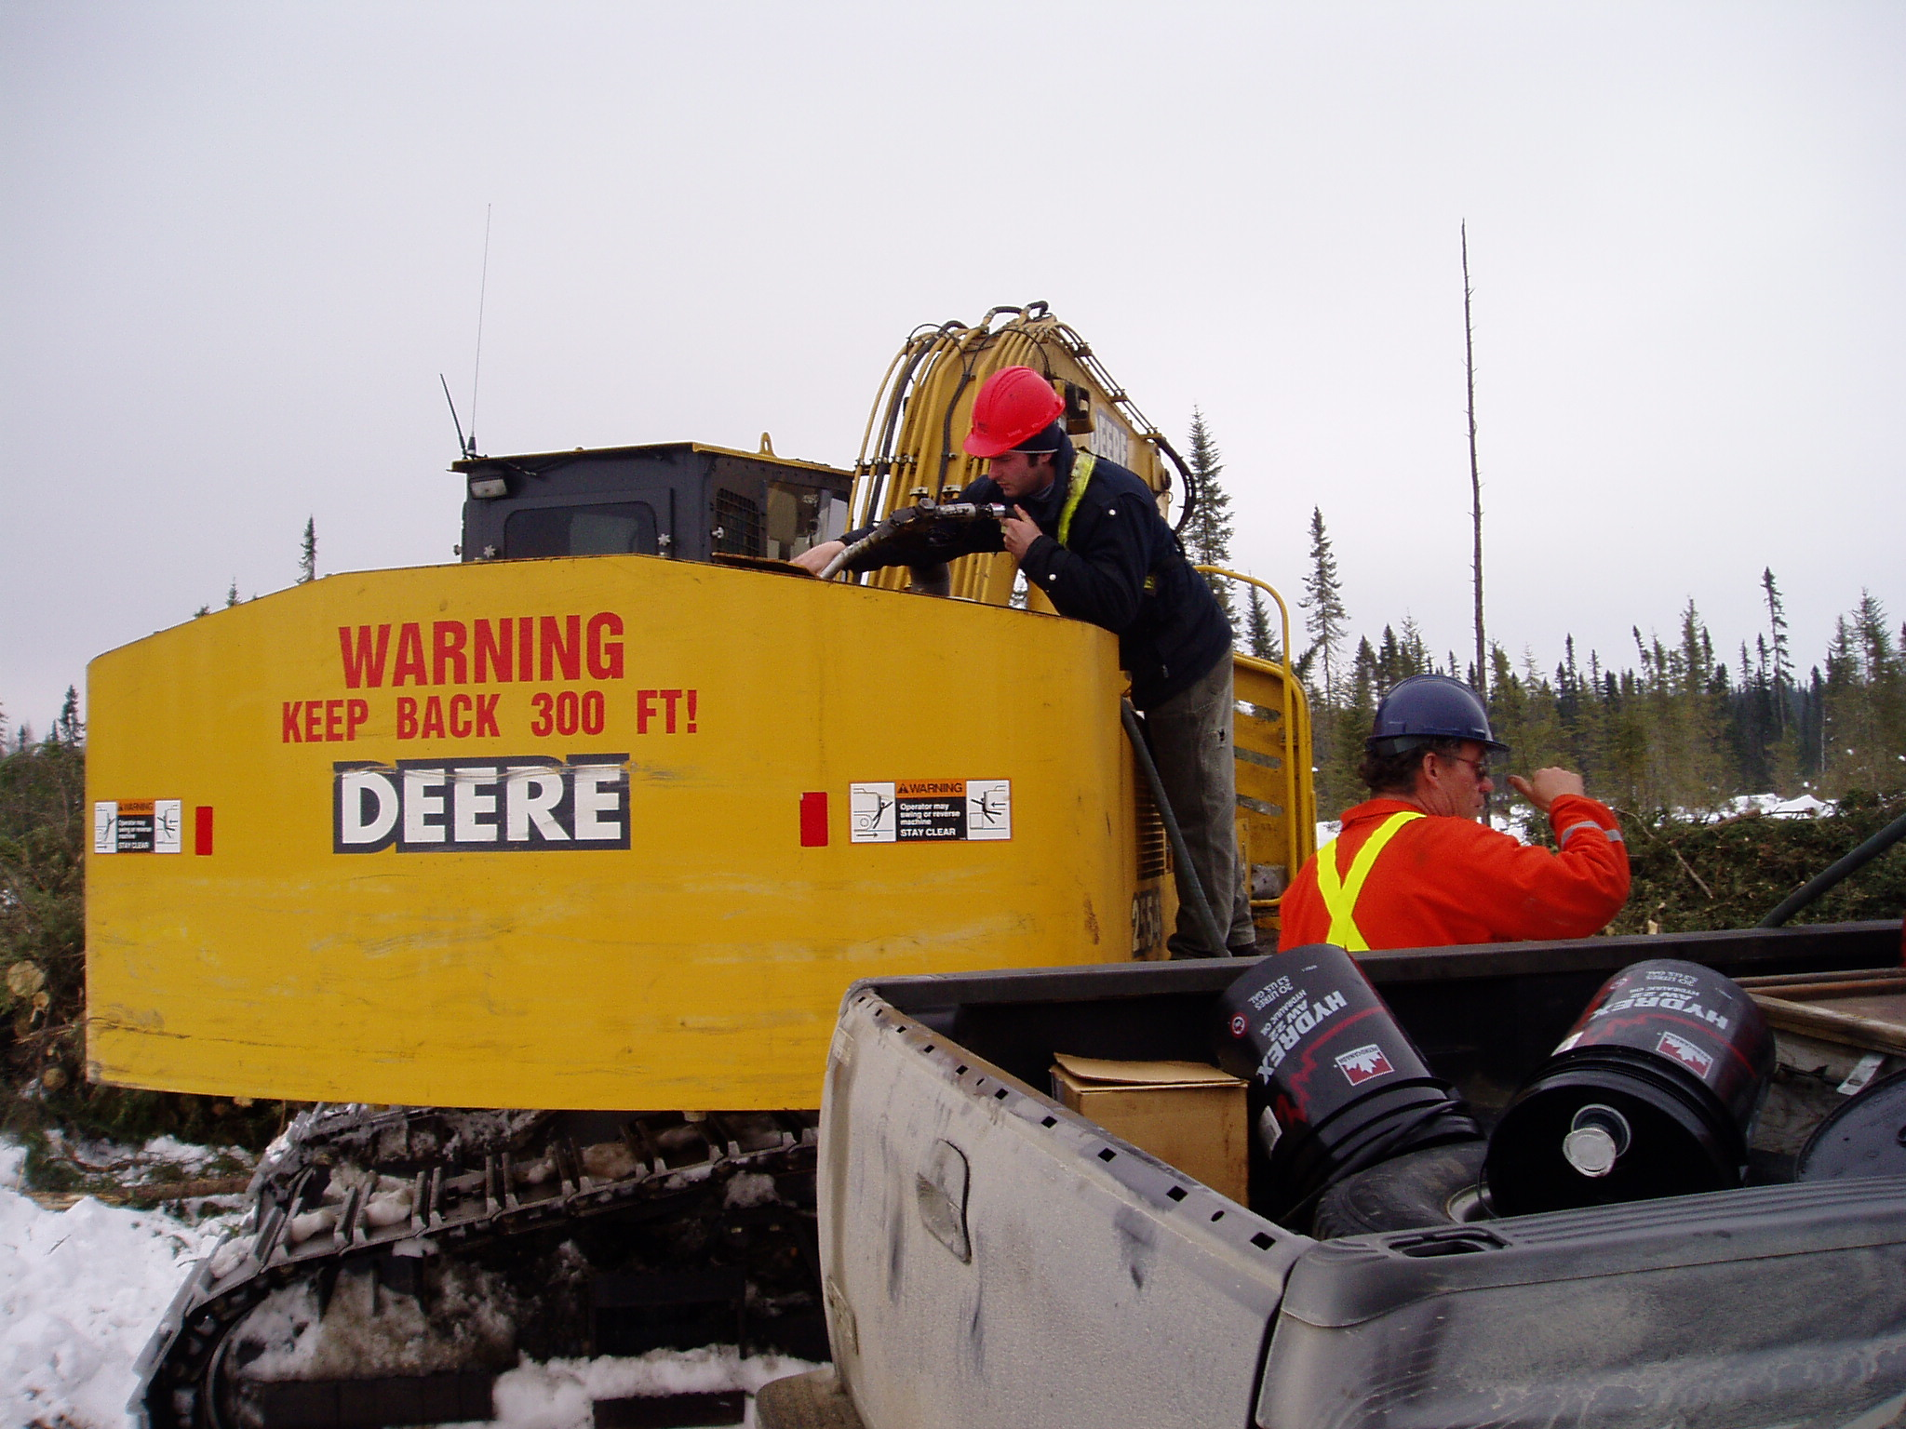
Fuel Storage: The Basics
No smoking within 3m (10ft) of tanks.
AUTO SHUT OFF NOZZLES ONLY
Operator must be present when fueling.
Do not jam fuel nozzles open.
Turn equipment off before fueling.
Do not fuel within 30 m of a stream, or lake.
Store fuel 100m from streams, lakes.
Store fuel on a level surface out of high traffic areas.
Store hoses neatly so they don’t drip. Put nozzle in drip catchment.
Know where the spill kits are.
Notes:
When fueling equipment from tanks on our license areas the following minimum requirements must be met:
Operator must be present when fueling equipment to prevent overfilling in case the automatic shut-off valve doesn’t shut-off
do not jam fuel nozzles open so fuel tanks will not overfill
turn equipment off before fueling to prevent an explosion hazard
do not fuel within 30 m of a stream, or lake to prevent fuel from entering watercourses and damage to the streamside vegetation
store fuel 100m from streams, lakes to that in the event of a spill or leak, fuel doesn’t enter the watercourse.
store fuel on a level surface out of high traffic areas this will prevent fuel from contaminating a larger area than necessary, and will reduce the risk of a tank getting hit by equipment and vehicles
store hoses neatly so they don’t drip. Utilize the drip catchment device on your tanks to prevent drips from hoses getting onto the ground and into the soil.
Know where the spill kits are. Spill kits should be available at each tank during fueling operations. Know how to use the kit and who to contact for reporting purposes.

Slide 37
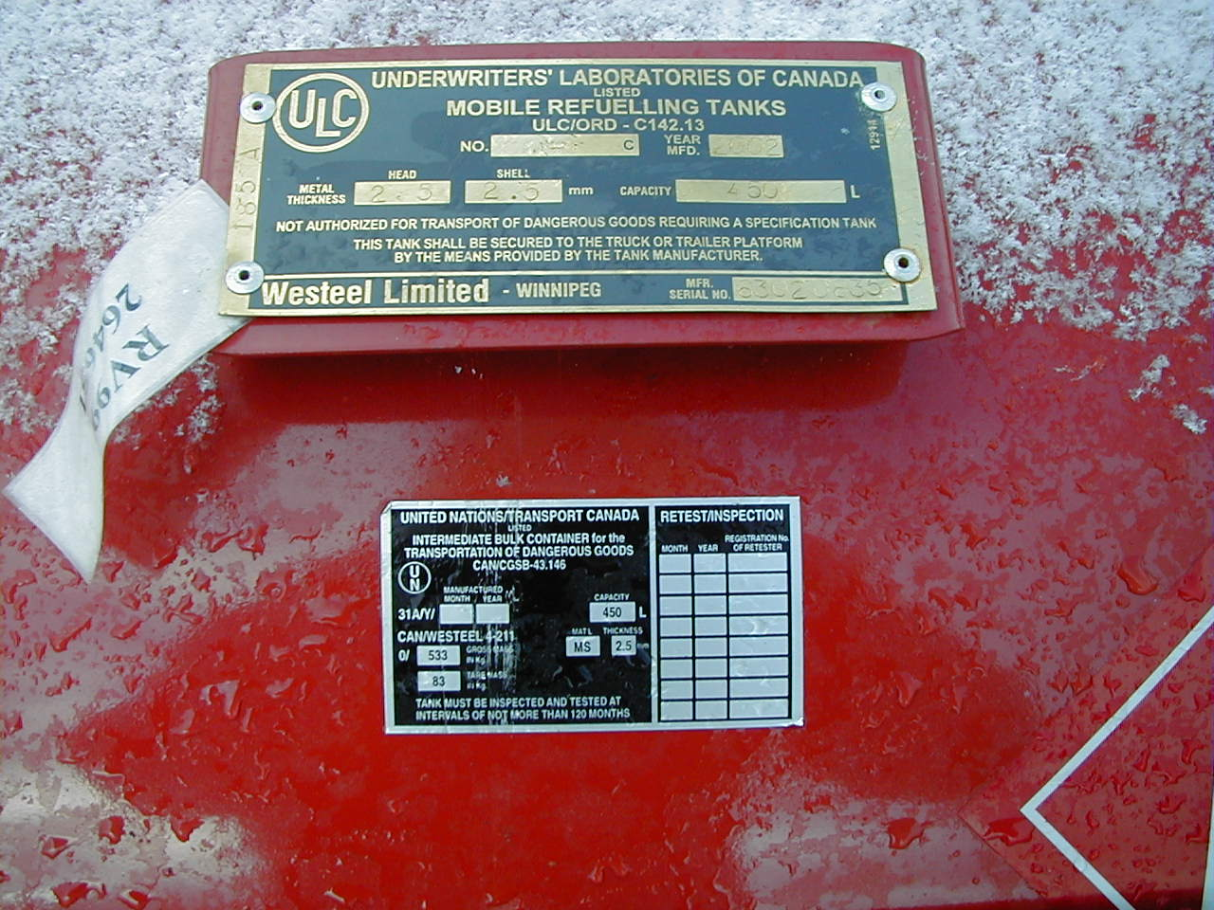
Design requirements labeling - slip or bulk tank
Pressure test at qualified TC inspector every five years from date of manufacture
ULC/ORD-C142.13-1997 brass label
Date of Manufacture (2002)
CAN/CGSB-43.146 label

Slide 38
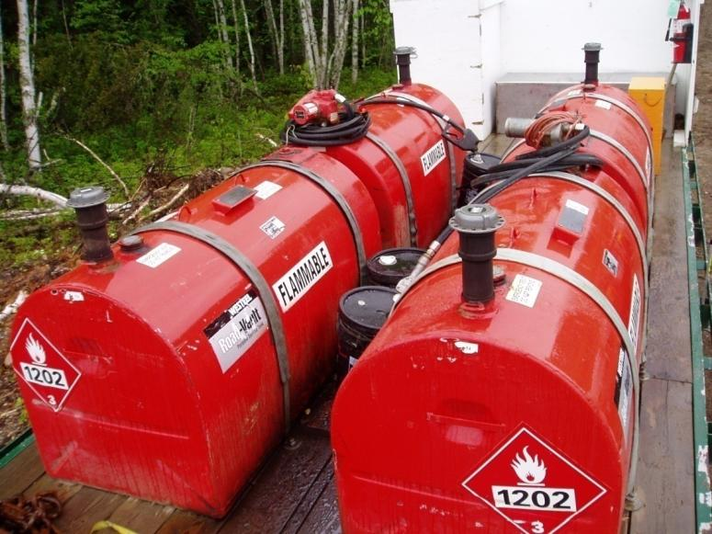
Fuel Tank Testing
All spec tanks regardless of size and type require testing by a qualified TC inspector five years from the date that it was manufactured. Contractors need to inventory within their operation what tanks were manufactured when.
Exception to this is specification tanks <450 liters. No testing requirements under Transport Canada.
Notes:
When fueling equipment from tanks on our license areas the following minimum requirements must be met:
Operator must be present when fueling equipment to prevent overfilling in case the automatic shut-off valve doesn’t shut-off
do not jam fuel nozzles open so fuel tanks will not overfill
turn equipment off before fueling to prevent an explosion hazard
do not fuel within 30 m of a stream, or lake to prevent fuel from entering watercourses and damage to the streamside vegetation
store fuel 100m from streams, lakes to that in the event of a spill or leak, fuel doesn’t enter the watercourse.
store fuel on a level surface out of high traffic areas this will prevent fuel from contaminating a larger area than necessary, and will reduce the risk of a tank getting hit by equipment and vehicles
store hoses neatly so they don’t drip. Utilize the drip catchment device on your tanks to prevent drips from hoses getting onto the ground and into the soil.
Know where the spill kits are. Spill kits should be available at each tank during fueling operations. Know how to use the kit and who to contact for reporting purposes.

Slide 39
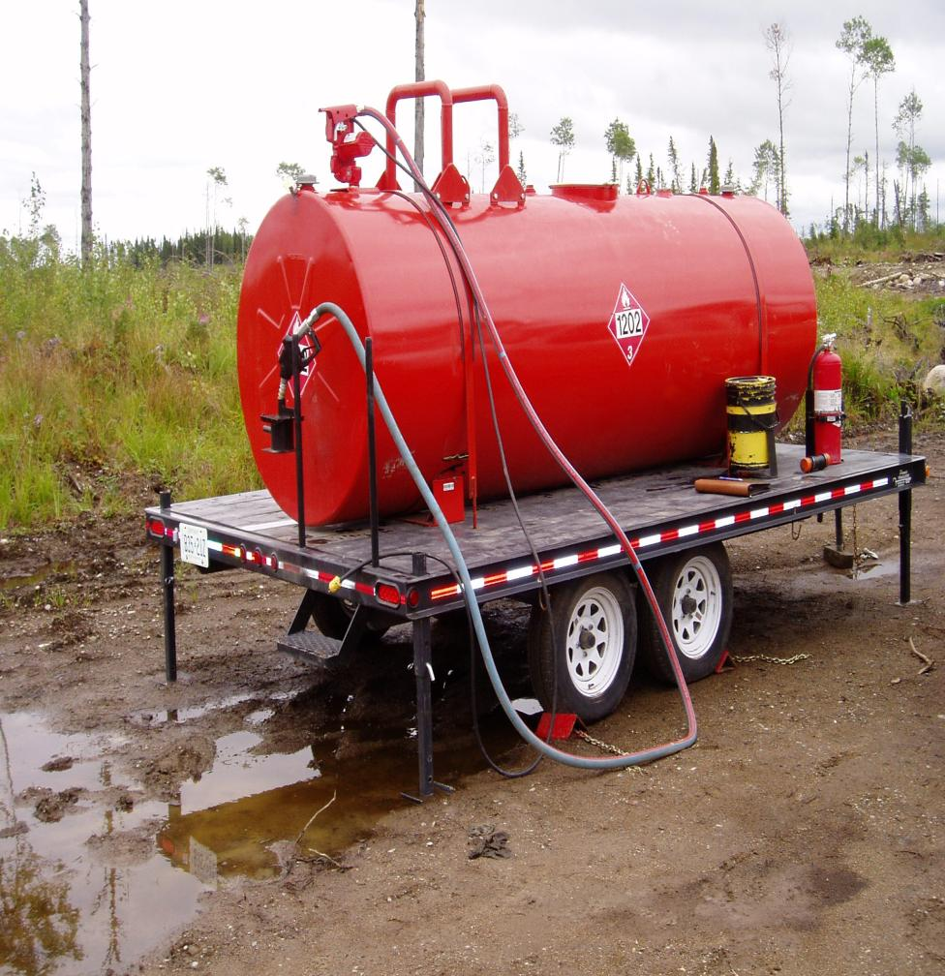
Compliant Bulk tank
TDG 1202 placard on 4 sides
Metal insulated strapping
Nozzle placed in drip catchment
Spill Kit
TDG Documentation
Wheels chocked
Other requirements
Fire Extinguisher suited to size of tank
TDG trained driver
Notes:
Here is a good example of a tank:
The battery has a solar recharger on it (not required by EMS but a good idea)
Hoses are neatly hung up to prevent dripping of fuel on the ground (hose requires a drip catchment container to prevent any fuel from dripping on the ground.
The tanks has Transportation of Dangerous Goods (TDG) placarding on all 4 sides.
Tanks is parked on a level site 100m from watercourses and out of high vehicle traffic areas. There is no potential for fuel to leak into watercourses or cause a public health hazard (I.e. fumes, explosion hazard, contamination of water).
The wheels are chocked to prevent unnecessary movement of the tank
Note: Fuel Tank does not meet ULC 142 standard required by Gasoline Handling Act and is still in contravention of the law

Slide 40
Labeling & Placards
  NEW
All labels, placards must be visible and in good condition. (not faded)
Accurately represent the material & ID the hazard. (flammable or combustible liquid, flammable or oxidizing gas)
The UN number may be part of the hazard placard or a separate sign.
Tanks equal to or less than 450 litres – one label (may be a placard).
Tanks greater than 450 – less than 2000 litres – one placard.
Tanks greater than or equal to 2000 litres – 4 placards. 2 on ends, 2 - front and back.

Slide 41
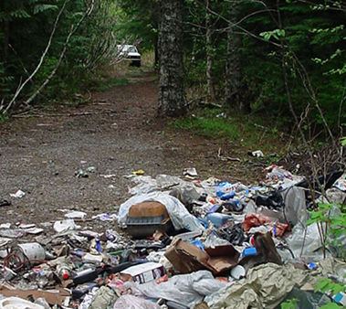
Operational Waste Recycling and Disposal

Slide 42
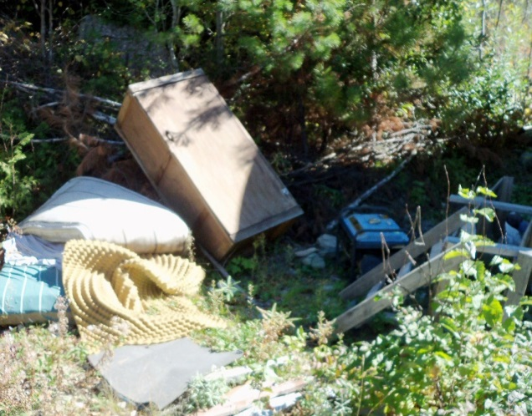
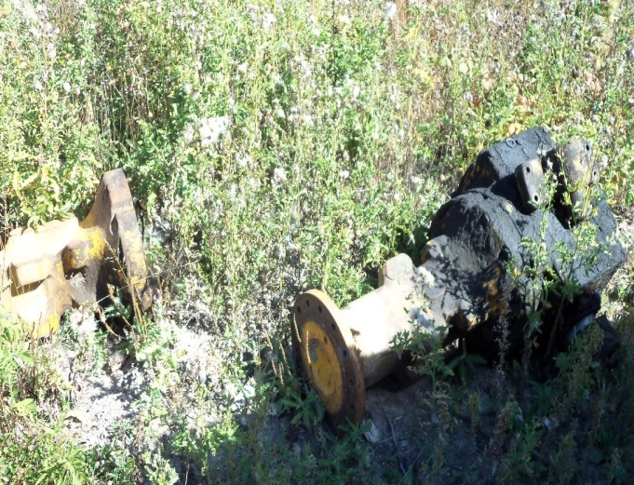
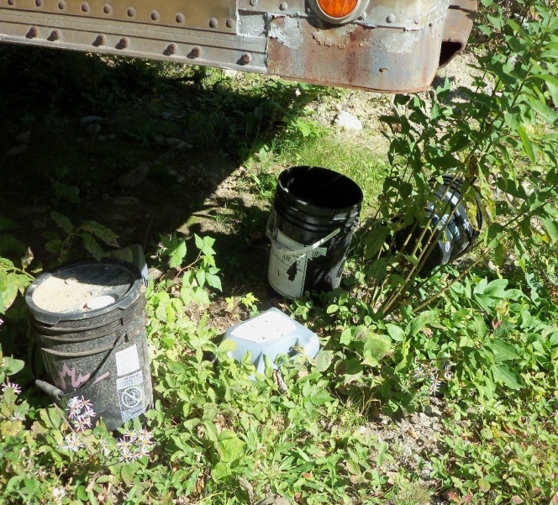
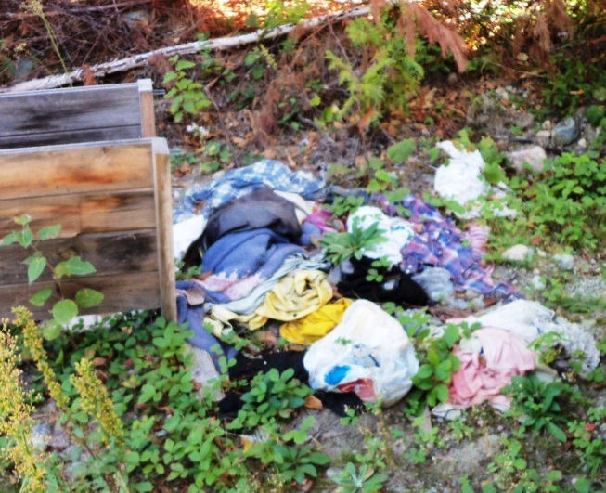
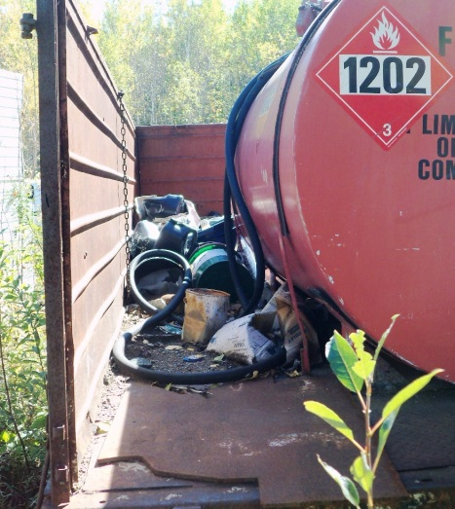
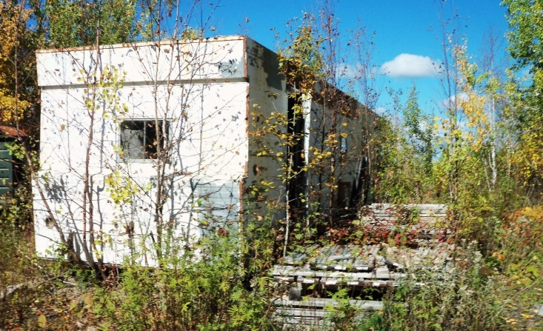
Garbage and Waste
Remove ALL waste and garbage from the site daily. This includes blue paper towels!
Recycle used oil, culverts, batteries, tires and other metal.
Return used oil. Label containers as used oil. Take a spill kit with you.
Take garbage to a
landfill site.
Ensure good house keeping practices
Ensure you have a MOE Generator Registration #
Notes:
Remove ALL waste and garbage from the site daily
Garbage includes everything from lunch waste (pop cans, orange peels, lunch bags, etc.) to used oil, tires, batteries.
Recycle used oil, culverts, batteries, tires and other metal
Recycle these materials where possible. Recycling may include re-using the products, reducing the amount of the product used, or returning the used product to a recycling agency who will dispose of the product.
Return used products to recycling depot
Return all used oil to a recycling facility. Do not leave on the ground. Approved site have a waste receiver number.
Do not burn oil filters
Dispose of oil filters at an approved facility that will take these items.
Take garbage to a landfill

Slide 43
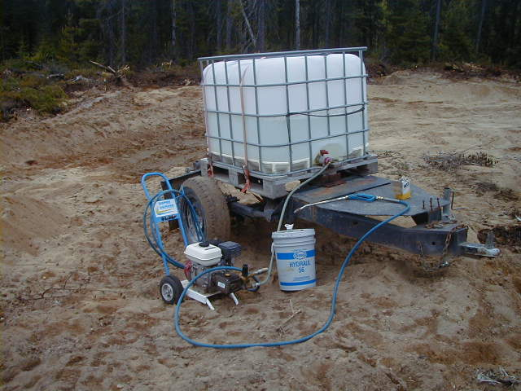
Equipment Washing

Slide 44
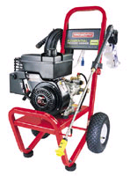
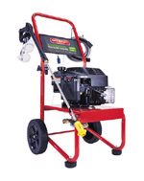
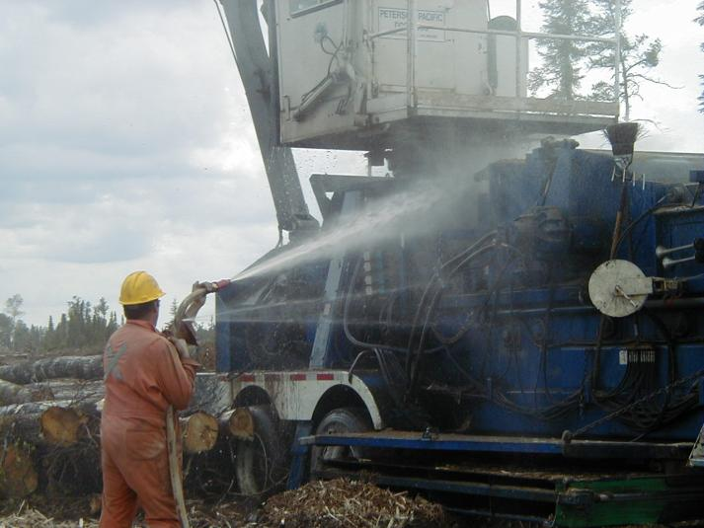
Equipment Washing
Do not wash equipment within 100m of a watercourse.
Do not allow washing water to enter watercourses.
Do not wash equipment in ponded water.
Wash equipment on roads and landing areas only.
Clean-up any oily residue left on the ground.
If in doubt STOP WORK & refer to your Equipment Washing SOP or ask your supervisor
Notes:
Do not wash equipment within 100m of a watercourse.
Do not allow washing water to enter watercourses. - prevent washing water and detergents from entering the waterbody. Build berms to direct waterflow away from the watercourse
Do not wash equipment in ponded water.
Wash equipment on roads and landing areas only. - avoid making clearings to wash equipment, utilize existing roads, landings and chipper pads.
Clean-up any oily residue left on the ground - remove any contaminated soil where the oil deposited on the ground is excess of 25 L (i.e. if washing off a leaking hose) and dispose of it at an approved landfill.

Slide 45
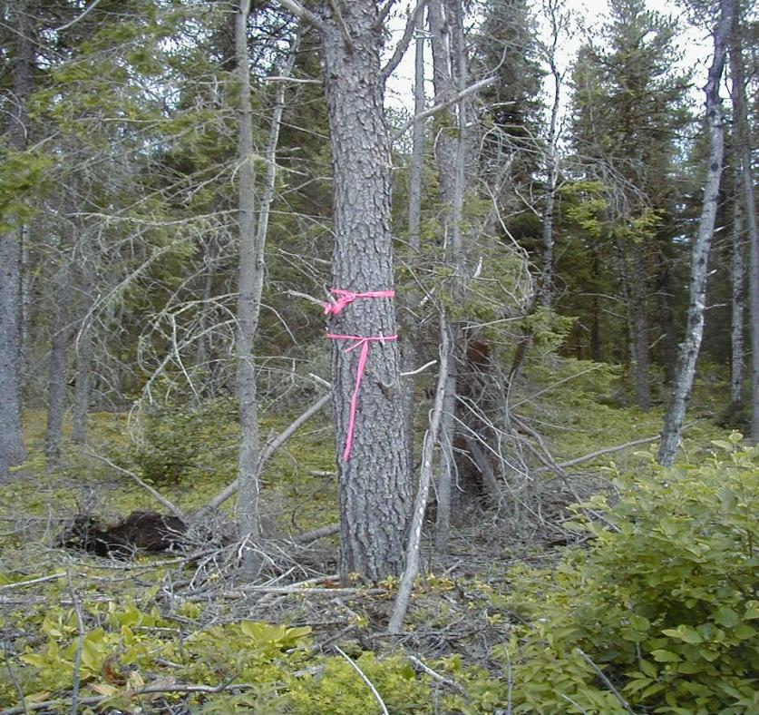
Road & Cutblock Ribboning

Slide 46
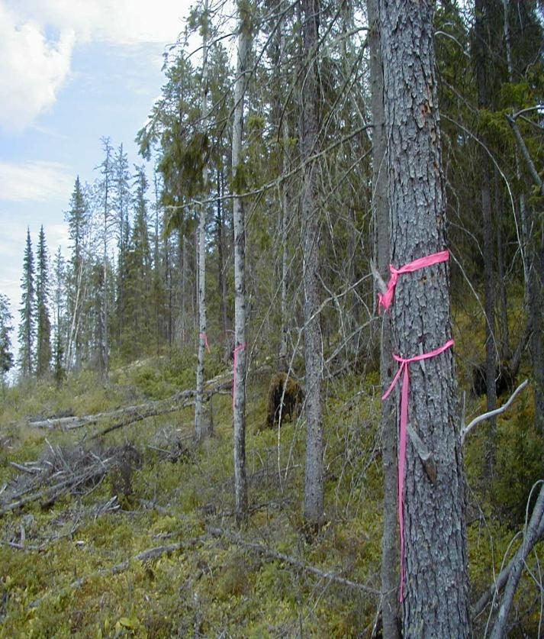
Ribboning Standards
Road & Cutblock Ribboning
When ribboning.
Use brightly colored flagging tape (PINK) as per Mitiigoog Ribbon Standards
Ribbon must be hung at intervals such that approximately 2-5 previous ribbons are visible where possible (except for obvious visible boundaries – i.e. roads, adjacent harvested cutblocks). “Ribbon is cheap - confusion is expensive!”

Slide 47
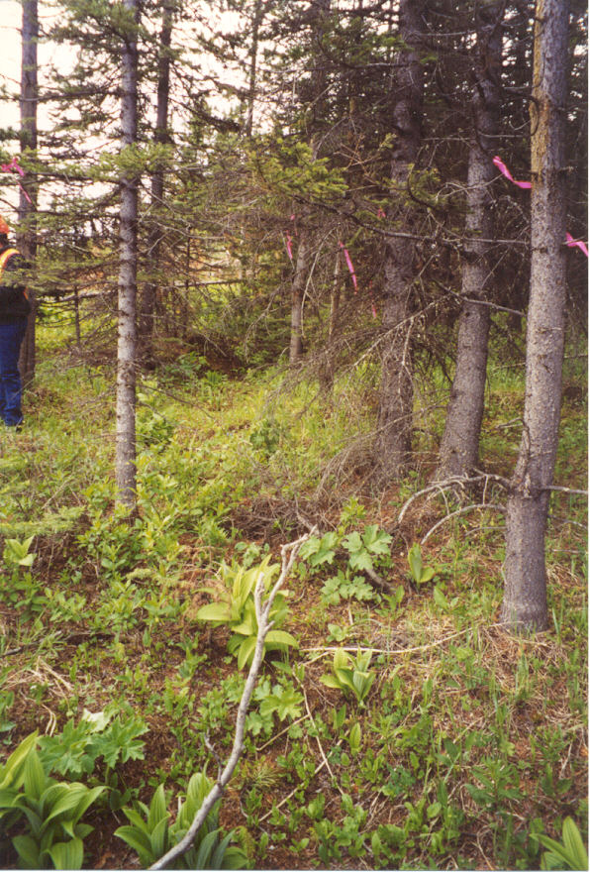
Ribboning Standards (cont’d)
Road & Cutblock Ribboning
Ribbon must be hung as high as possible (preferably un-merchantable timber or on branches).
All old ribbons (old boundaries, old road location ribbons) that may confuse harvesting operators shall be removed. Especially true where mining exploration is high. Notify Miisun of any concerns.

Slide 48
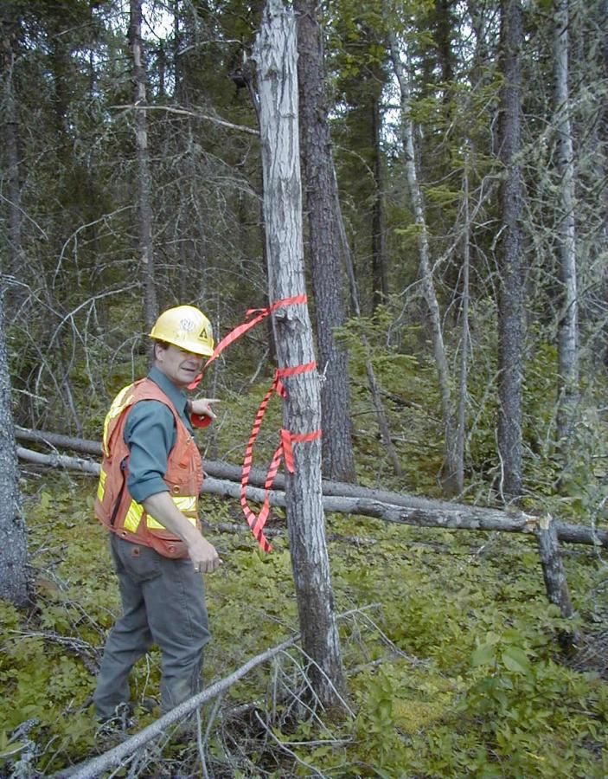
Ribboning Standards continued
Road & Cutblock Ribboning
Road ribboning identifies…
Start & End of roads
Road Junctions
Corners / changes of direction
Narrowing of right-of-ways widths at stream crossing AOCs and highway entrances.
Cutblock ribboning identifies…
Change in direction of block boundary
Start and end of boundary lines

Slide 49

Ribbon Standards
Road & Cutblock Ribboning
An example of road identification
Start and end of roads with 3 ribbons
Single ribbon to mark continuous direction
Two ribbons indicate corner, beginning/end of curve or a change of direction
An example of cutblock identification
3 ribbons identify the beginning / end of cutblock boundary
2 ribbons indicate a corner or change of direction
Color not an issue but be consistent with its application.

Slide 50
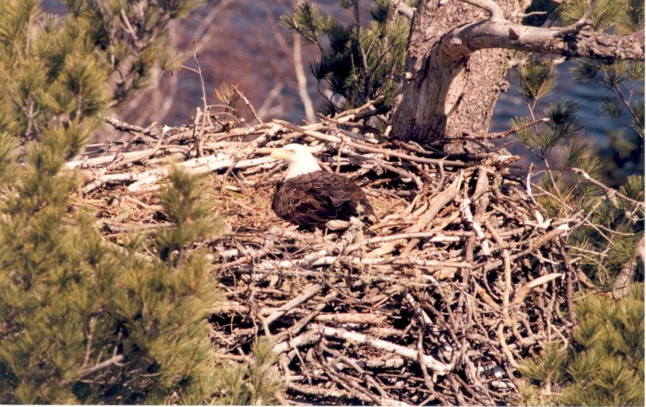
Ribbon Standards
Road & Cutblock Ribboning
Where ribbon lines between allocated and unallocated blocks intersect a road, the ribbons are extended down the road a minimum of 20 meters along the face of the unallocated block. This could save you a very costly fine.
Ribbon any AOC reserves or significant features

Slide 51
Marking Adjacent to Private Property,
& Protected Areas
Road & Cutblock Ribboning
Adjacent to Private Property and protected areas (From SOP) | When conducting forest activities adjacent to private property and Crown protected areas the following steps should be taken: Contact Land owner of the land parcel before any ribboning is conducted and operations commence. Personally contact the landowner to inform landowner of operations, the authority to which the operations are being conducted, the planned location of the operation and seek an agreement regarding where the operations will be conducted on the ground. If personal contact is not possible notice will be made in writing so that all correspondence can be tracked and confirmed. The lack of response from a landowner about the notice does not mean agreement with or acceptance of a marked limit of the operations. This notification is in addition to any generally provided during the preparation of the FMP. If agreement is reached then the boundary may be marked according to the agreement with the landowner. The decision to engage the services of a surveyor to locate the boundary versus taking the risk of operating near the property boundary and incurring liability rests with the company. Options for boundary marking: Can be surveyed by an OLS. Forest operations can be conducted up to the established surveyed line. Ensure surveyed boundary is well ribboned prior to forest operations being conducted. Follow ribboning procedure above and pre-work instructions according to the Soil Conservation SOP. Ensure no damage occurs to existing survey markers, corner posts, monuments, iron bars, blaze markers or other survey markers. Buffering the area between forest operations and where the actual property boundary is believed to be. Document and communicate to landowner. Provide rationale as to why buffer was left in Compliance report. For both options ensure records showing proof of notification of landowner. This is a condition of our SFL’s.

Slide 52
Marking Adjacent to First Nations
Road & Cutblock Ribboning
Adjacent to First Nation Reserves (From SOP) | Communication regarding the harvest plan, timing, and location of the block must take place with the involved adjacent community. Of key importance during these communications would be agreement as to where the recognized boundary is located on the ground (i.e. location of an existing blaze line, steel posts, etc.) In cases where a blaze line exists that does not precisely align with the location of the GPS boundary from the approved FMP, the licensee will recognize the option that is farthest from the community. This decision will be communicated to the community before harvesting occurs. A 60m buffer will be applied to this recognized boundary when ribboning is conducted. In cases where a blaze line does not exist or cannot be located, a plan will be developed with the community to determine the location of the recognized boundary. This may involve a request to INAC to have the boundary surveyed, or may involve reaching an alternate agreement with the community if INAC cannot supply the information in a timely manner.

Slide 53
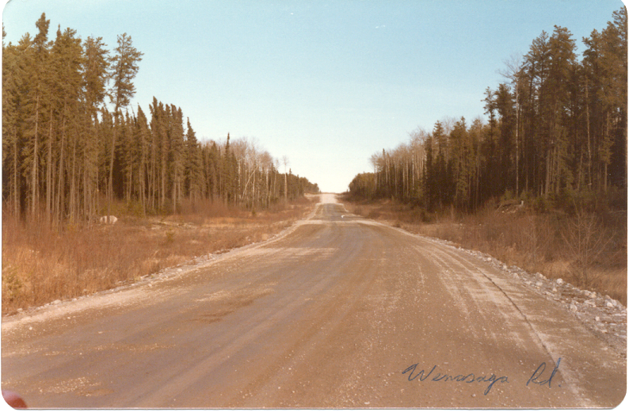
Road Location

Slide 54

Road Location
Planning for Road Location
Road must be approved in the Forest Management Plan The proposed location must stay within the FMP road corridor – these boundaries are shown on all pre-works. If possible, avoid:
Rock outcrops
Swamps and treed muskegs
Sharp curves or steep grades
Wet spruce lowland stands
Unstable areas (i.e. slumping slopes, etc.)
Water crossings
Other values that could be negatively impacted by the road.
Patented/private land
Variance outside of road corridor.

Slide 55

Road Location
Planning for Road Location (cont’d)
If actual road right-of-way location varies outside of proposed corridor, a FMP amendment will be required.
Use most current photos to help with layout functions
Field Location Conduct reconnaissance walk(s) through the proposed road location area. Observe, document and consider operational issues mentioned before. This should only be done by experienced personnel. Huge $$ on the line with this function……

Slide 56
Road Location
Field Location (cont’d)
Locate road centreline. Tie flagging tape according to the Road and Cutblock Ribboning SOP.
Ensure the road right-of-way is within the 500m approved corridor identified in the FMP. Where road passes through AOCs ensure the right-of-way is within the refined 100m road corridor.
Plot actual location of road centreline onto aerial photos, confirming adherence to corridor allowances.
Area of Concern (AOC)
Narrow right of way widths around stream crossing AOC’s to 15-20 metres and highway approaches to 15 metres.
Capture road location information in the Prework instructions and map for the road. Review with contractor prior to cutting ROW.

Slide 57
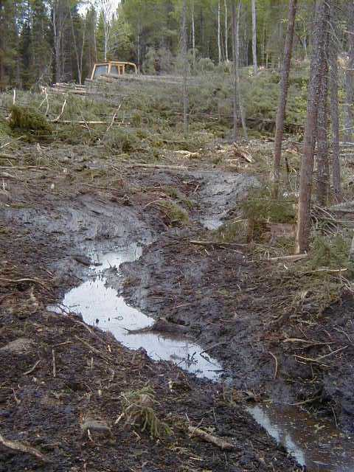
Soil Conservation

Slide 58
Soil Conservation
What’s the Real Issue?
Pop Quiz: The main issue that experienced foresters have with sites where rutting and/or compaction have occurred is
_______________?

Slide 59
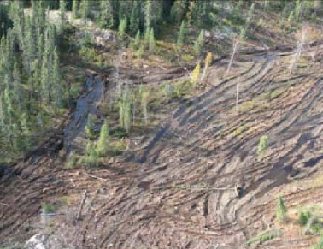
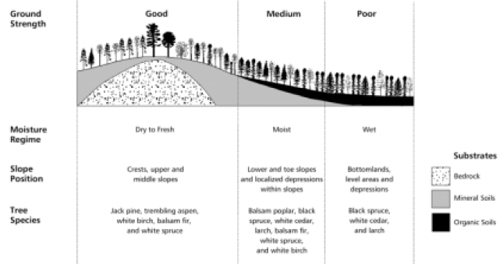
Soil Conservation
Lowlands and fine textured soils (i.e. silts & clays) are most prone to rutting and compaction – know your ground, and observe the footprint you are leaving.
Rutting is highly visible, compaction is not as visible. Both affect the ability of the FOREST TO REGENERATE

Slide 60
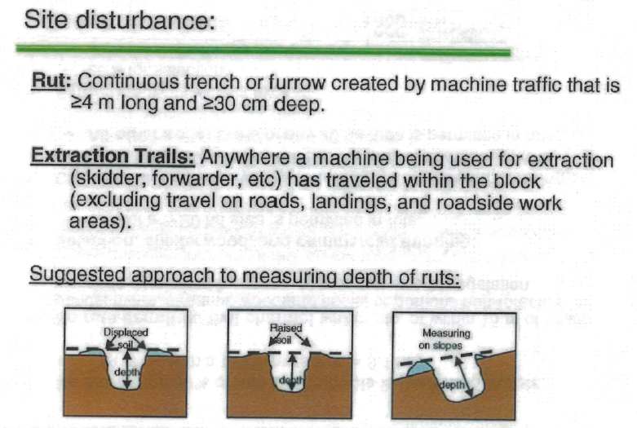
Soil Conservation
NEW
Rutting and compaction often go hand in hand
Both can cause problems with reforestation (ability to establish at all, ability to establish targeted species)
Loggers are the ‘first users’. If you truly want to understand your long-term impact on reforestation, participate in a year-10 regeneration survey and observe the patterns (tree heights, species, densities, etc)
FERIC REPORT: The best results for low ground disturbance ALWAYS come from organized operations – where equipment is managed by someone on-site who knows the variable ground conditions in a block.

Slide 61
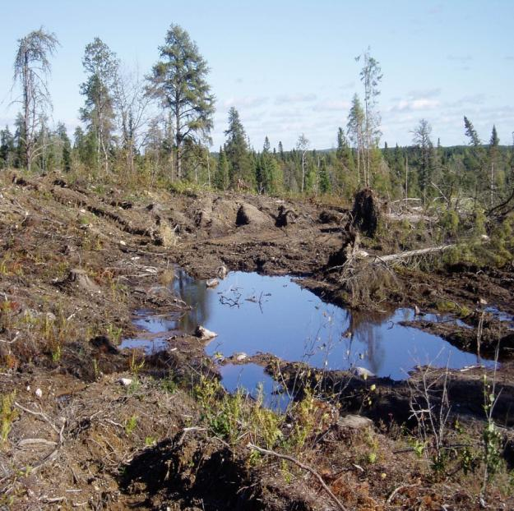
Soil Conservation SOP
Purpose: SOP will control/manage soil disturbance & compaction within the cutblock
Applies to activities who may impact soil productivity during harvesting, road construction or site preparation activities. (anything that operates in cutover should have pre-work)
Manage and control this with the pre-work instructions & maps.
Contractor/supervisor completes one on one with all operators operating in cutover.
Operators execute plan. Apply STOP WORK procedures if:
  unsure of instructions or location.
  Sensitive site is found not ID on pre-work
  Operations not in compliance
  Job considered unsafe
  After heavy rainfall events (if applicable)
If any of these conditions apply STOP WORK or relocate to a safe portion of the block.
Operators & supervisors need to report where localized disturbance occurred. (>30 m X 30 m)
STOP WORK and relocate to a different area if soil disturbance continues.

Slide 62
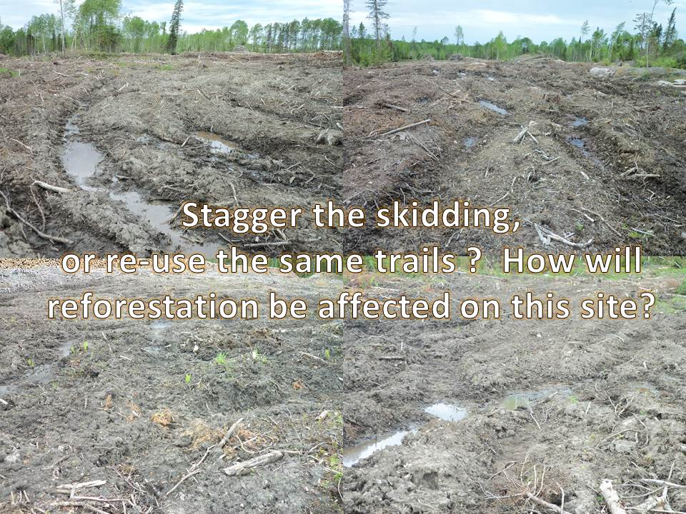

Slide 63
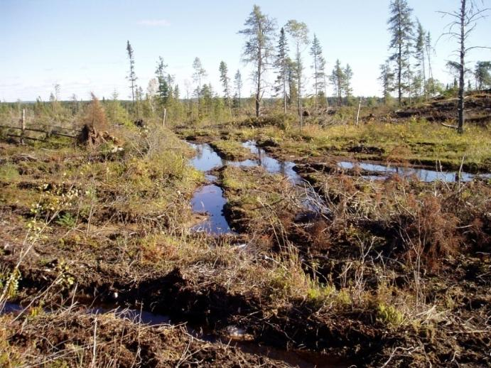

Operating around wet areas
Skid around wet pockets or avoid cutting altogether.
Avoid site prepping wet areas.
Notes:
Picture 1
Skid around wet areas where possible
Skid wood out of wet draws
Avoid skidding down the same skid trail
Where rutting is continuously occurring, move to higher and drier portions of the block.
Picture 2
disperse the skidding where ground conditions are dry

Slide 64


Good things for skidding
Corduroy crossing to reduce ground disturbance when crossing wet areas repeatedly (use non-merchantable timber)
Cut in the winter time or use light impact equipment if available
Notes:
Picture 1
Where wet areas require crossings use only one crossing
Use non-merchantable wood to corduroy across wet areas. Skid across wet areas only on these crossings.
Picture 2
Again disperse the skidding. Do not use the same skid trails all the time.

Slide 65

Keep wood out of wet draws
Keep debris out of small draws and watercourses
Notes:
Pile debris outside of wet areas, draws, and watercourses. The debris limits the regeneration in these very productive areas.
Make large piles rather than many small piles.
It is illegal to place any type of debris into a watercourse without government approval.

Slide 66

Harvesting

Slide 67

Harvesting - Falling / Bunching
MOST IMPORTANT PART OF OUR EMS: PREWORKS
Contract Leader Reviews Pre-Works with Operators for Each Block
AOCs
Notes:
Pile debris outside of wet areas, draws, and watercourses. The debris limits the regeneration in these very productive areas.
Make large piles rather than many small piles.
It is illegal to place any type of debris into a watercourse without government approval.

Slide 68

Harvesting - Falling / Bunching
Do NOT cross ribboned boundary. Use a bushrow along face of ribbons.
Fall trees away from watercourses.
Fall trees to allow easy skidding away from wet draws.
Reach into and fall trees out of wet areas.
Leave ribbons intact & standing.
STOP WORK and contact supervisor if you come across an unidentified stream that was not shown on the map (BUNCHER OPERATORS ESPECIALLY)
Notes:
Do NOT cross falling boundary into adjacent timber, or plantations
fall trees away from watercourses to prevent wood and debris from entering the stream as well as assist skidding away from the watercourse
fall trees to allow easy skidding away from wet draws - ensure trees are felled to prevent skidders from getting stuck or causing excessive soil disturbance in wet areas, draws
reach into and fall trees out of wet areas - reduce rutting and compaction by limiting the amount of equipment movement in wet areas
leave ribbons standing - ensure the trees with ribbons tied to them are left standing for future reference

Slide 69

Harvesting - Skidding
Avoid skidding through wet areas and draws.
Avoid skidding through WS02 AOCs – use a skid crossing
Place corduroy in draws and wet areas to minimize soil damage from repeated crossings.
Carry back debris and place on the skid trail to reduce rutting.
Skid on high dry ground.
Skid out from and go around wet areas where possible.
Avoid snags & advanced growth
If excessive rutting / COMPACTION is occurring, STOP WORK! Relocate, inform supervisor.
Notes:
Avoid skidding through wet areas and draws - limit the amount of skidding through wet areas and draws, try to skid around these areas..
Place corduroy in draws and wet areas to minimize soil damage from repeated crossings. Where crossings are required, place corduroy on the ground and drive machine over corduroy
Carry back debris and place on the skid trail to reduce rutting - Use the skidder to carry back debris out onto the block. Place debris where there is a potential to cause rutting.
Skid on high dry ground - locate skid trails and main skidding routes on high dry ground. Locate on high dry, rocky sites where possible.
Skid out from and go around wet areas where possible - plan skid patterns to go around as many wet areas as possible. Avoid crossing wet areas repeatedly.

Slide 70


Harvesting - Processing
Follow provincial utilization and mill quality standards. (OFI Focus area in the 2016 SFI Audit) What is the 10 cm diameter class mean? What’s the minimum length?
Refer to the Debris Disposal SOP for chipper and delimber debris management.
Watch Topping size!
Notes:
See Scaling Manual under wasteful Practices page 91 and 92
10 cm DOB is 9-11 cm class

Slide 71

Watch Topping size!

Slide 72


Harvesting – Chipper Debris
Unless otherwise indicated, chipper debris must be carried back a distributed throughout the block – See Debris Disposal SOP for very specific strategies (i.e. shallow vs. organic soils)
Chipper pads must be cleared of debris – no ‘mats’ let behind, rehab with a hoe and spread material (<20cm, non continuous). Reforestation of chipper pads is difficult – this is assessed in EVERY BLOCK for COMPLIANCE MONITORING !
Locate your chipper pads carefully – they create a congested areas where skidder traffic is very concentrated – know your ground, and the path that the skidders will use...
Poor chipper pad location in non-frozen conditions will lead to concerns with rutting and/or soil compaction.

Slide 73


Harvesting – Chipper Debris
GOOD IDEA: Putting fine chipper debris on top of a coarse roundwood pile
BAD IDEA: Pushing chipper debris into standing timber – compliance issue

Slide 74


Harvesting – Chipper Debris
GOOD IDEA: 95% of material carried back, remainder spread to <20cm thick at landing
BAD IDEA: Spreading debris at the landing >20cm thick – compliance issue

Slide 75




CHIPPING DEBRIS – THE BOTTOM LINE
You can’t leave it at roadside >20cm thick (you’ll have to go back….
MAKE SURE BEFORE YOU LEAVE THE BLOCK THAT THESE AREAS HAVE BEEN MANAGED

Slide 76

Harvesting - Loading / Hauling / Piling
Limit soil disturbance (i.e. #of turn arounds)
Pick-up all pieces of wood.
Pile debris properly (bigger piles rather than smaller).
Ensure that no rocks, forked pieces or shorts get loaded on to the loads.
Remove all waste and garbage from the site.
Notes:
Pick-up all pieces of wood - ensure no merchantable wood is left on the landing / road side.
keep wood on landing - keep wood on the landing area. Do not push debris into standing timber, or outside of the block boundaries or road right-of-ways,
don’t put dirt or snow into the piles - to have a good burn, piles need to be free of any dirt or snow.
Skid chipper debris back into cut-over where required. - where required skid chipper debris back into the cut-over. Spread the debris evenly and not greater than 20cm deep. Do not impede the regeneration.

Slide 77

Roundwood Debris Disposal

Slide 78




Roundwood Debris Disposal
INCOMPLETE BURNS ON HARDWOOD PILES ARE AN ISSUE

Slide 79

Delimber Debris Piles
Debris Disposal
Ensure a safe and efficient burn by:
Moving debris out of standing water.
Aerating piles to allow for rapid ignition and a complete burn
  Pile / spread delimber debris on non productive ES11 & 12 bare, rocky sites at roadside only, where practical. Do not burn these piles placed on roadside, non productive sites!

Slide 80

Debris Disposal
Delimber Debris Piles
Mix softwood debris into hardwood piles for ease of ignition, if available.
Minimizing debris, soil, snow and large stumps being pushed into the piles.
Not constructing on grub piles left from road/landing construction.
Pile slash far enough from tree line so that when piles are ignited no standing timber impacted (@10m)
Creating large piles versus small piles.
Excellent Pile

Slide 81



Slide 82

Road Construction

Slide 83

Road Construction - R/W Clearing
Ensure one on one Pre-work review with operators.
Do not fall timber across r/w boundaries
Fall trees away from watercourses
Narrow R/W to 15m within the first 30m off of highway right of ways. Narrow to 15-20m at watercourse AOCs. (See Ref Card)
Remove all merchantable timber from site prior to road construction
Where brush matting is used ensure merchantable wood is scaled – Corduroy form in Binder
Dispose of harvest debris by piling, incorporating into road pushouts or spreading. Do not pile debris into bush line!

Slide 84

Road Construction - Subgrade
Follow prework instructions for road specs.
Clear, grub and stump sub grade location.
Do not push debris into standing timber
Do not grub wet or unstable sites
Locate landings on unproductive rock
Dispose of stumps and debris by incorporating into fills or placing on road banks to control erosion
Monitor road specifications for road information (road width, ditch slopes, etc.) found in Table 1 of the Road Construction SOP in your manuals.

Slide 85



Road Construction – Erosion Control
Straw mats, hay bales, check dams, geotextile fabric, seed mix, cross drain pipes, etc. are all available.
New roads are the highest erosion risk we have: SLOPE and FINE SOILS are a bad combination !!!
Ask for help if you need it !!!

Slide 86

Watercourse Crossings

Slide 88

Culverts on Roads
Watercourse Crossing
Whether the streambed will support the culvert (i.e. No settling of the bed – may need to place sand or fine gravel to stabilize culvert bed).
The grade of the culvert reflects the grade of the natural streambed.
A minimum of 10% of the culvert diameter, is submerged BELOW the streambed. DO YOU KNOW WHY???
Backfill is adequately compacted around the pipe. Use clean sand or gravel only.
Ensure culverts are the correct length to permit banks to be sloped at an angle of 2:1 and stabilize with coarse material.

Slide 89

Culverts on Roads
Watercourse Crossing
Vegetation if required should be established to prevent sedimentation.
Pipe should extend beyond the fill slope far enough to ensure road grade does not slide overtop of the culvert inlet and outlet.
Culvert Length = (Fill Height X 4) + Road Width
Protecting culvert inlets and outlets from erosion with rocks or cobble sized stones.

Slide 90

Watercourse Crossing
Culverts on Roads
Conducting instream work during low water periods. (no instream activity: cool water => April 1 through June 20; cold water => September 1 through May 31.)
Upstream ponding should be avoided – get that inlet below the streambed
You may only use that road for 3 months, but the pipe may be in there for 15 years. Install it for the long term…

Slide 91

Culvert installation
Enough fill over pipe
Good 2:1 fill slope
Good rip rap/geotextile
No upstream ponding
Culvert submerged 10% below stream bed
Pipe slope is the same as the stream
Notes:
Culverts installation
culvert slope is the same as the slope of the stream
a minimum of 10% of the culvert diameter is submerged below the streambed
Backfill and compact sand or gravel around pipe
Ensure culvert is correct length to allow fill slope angle of 2:1,
Protect culvert inlets and outlets from erosion with rocks or cobble
avoid upstream ponding
Use thin layers of backfill during winter culvert installation

Slide 92

Road Construction - Drainage
Rounded ditch bottom
Ditch block
2:1 ditch fill slope
Culvert to drain ponded water
Notes:
Ditchline construction:
Do not disturb highway ditchlines
ditch has rounded bottom
slope cuts and fills to 2:1 angle
Prevent ponding of water - drain the area where necessary

Slide 93

BRIDGES

Slide 94


BRIDGES
We inspect all our bridges on regular inspection cycles. Most common issues are:
Accumulation of debris on deck
Damaged signage
Damaged railings
Minor erosion at ends
Indications of abutment settling

Slide 95

Watercourse Crossings - Bridges
What’s missing on this bridge? (2 items)
Notes:
Bridges
Ensure straight approach to bridge
Cross stream at a 90º angle the direction of flow
Do not place earth or gravel on the bridge deck surface.

Slide 96

Watercourse Crossing
Bridges
Minimize stream bank disturbance.
Align bridge abutments and piers to be parallel with the direction of water flow.
Stabilize cribbing structure prior to placing deck.
Where possible, place geotextile to prevent siltation passing through the cribbing.

Slide 97

Watercourse Crossing
Stabilization
Once the structure has been installed, stabilize the cut and fill slopes around the structure (2:1 slope ). Follow the Prework Instructions for erosion control measures. Measures may include:
  Revegetation of the slopes, approaches, and / or ditchlines near the crossings.
  Rip rap to protect the culvert inlet and outlet.
  Rip rap to protect cribbing and abutments of bridges.

Slide 98
Watercourse Crossing
Stabilization (cont’d)
Siltation fences placed along the streambank edge to control deposition.
Divert ditchline run-off away from the watercourse.
Place slash debris or straw mats over exposed mineral soil.
Where necessary, control erosion and siltation in ditchlines adjacent to stream crossing approaches. Use rock/soil dams, hay bales, silt fences, log jams, etc.

Slide 99

Watercourse Crossings - Bridges
Notes:
Bridges
Ensure straight approach to bridge
Cross stream at a 90º angle the direction of flow
Do not place earth or gravel on the bridge deck surface.

Slide 100

Aggregate Pits

Slide 101
Aggregate Pits
Recognizing Improvement on the Kenora Forest
When do you rehab pits?
What is considered a pit?
What is set back on pit?

Slide 102
Aggregate Pits
Pit construction / Usage – new pits:
Must be within the 500m primary/secondary rd corridor or
Within approved harvest block or
Within a tertiary road that’s included in the AWS.
ENSURE A 5 METRE SETBACK TO BUSHLINE! (O.F.I. IN 2016 SFI AUDIT)
CONTROL THE WATER IN / OUT
VERTICAL FACES <3m
MUST BE REHABBED WHEN DONE
THIS INCLUDES small SAND PITS ALONG HAUL ROADS

Slide 103

Aggregate Pits
Previously Constructed pits:
Must be ID as approved on the pre-work. If not STOP WORK! Obtain approval from Miisun Rep.
Follow pre-work usage specs in SOP and pre-work instructions. Monitor on a continuous basis.
Pit Reclamation:
Progressive rehab on an ongoing basis!
For Category 9 pits that have not been renewed, reclamation must occur prior to the 120 month exemption timeframe. Follow rehab instructions in step 6 of the SOP.

Slide 104


Aggregate Pits
NO CAVE PITS –
SAFETY CONCERN
Pit Rehab

Slide 105
Aggregate Pits
Pit Reporting - Category 14:
Cat 14 pits locations are tracked and reported by Miisun and submitted to MNR by Jan 31st. This includes GPS coordinates of every haul support Cat 14 pit and road construction support pit (about 25 last year) linked to each licensee.
Pit Reporting - Category 9:
Miisun to ensure approvals are in place:
Approval Type | Required when building or using pits that…
Highways Entrance Permit (if required) from Ontario Ministry of Transportation | Enter any numbered Kings or Queens Provincial highway
MNR’s Aggregate Permit for Category 9 aggregate pits. | Do not meet the definitions of a Category 14 pit.
Written approval from Miisun Supervisor. | Are constructed under any MNR approved Category 9 permit and conditions.

Slide 106
Aggregate Pits
Miisun supervisor checks status of pit (active or inactive) from MNR with OFIS records. Update database accordingly.
Pit Construction:
Contractor completes one on one pre-work instructions with operator(s) to implement plan.
If drawing from previously constructed pit, verify conditions (if any) for use of the pit
Contractor/operators implement plan. Monitor on a continuous basis to conditions in pre-work, site plan and conditions.

Slide 107


Our Cat 9 Pits
You cannot produce or remove material without 2 things:
Permission from Miitigoog (Miisun)
Means of tracking the amount of material, and communication of those precise volumes to Miisun

Slide 108

Aggregate Pits
Category 9 Pit Rehab:
Rehab according to conditions of the permit.
Category 9 Pit Reporting:
Miisun completes and submits Form #590 to MNR by Sept 30th.
Miisun supervisors will maintain OFIS database by entering or updating pit boundary location and status on an ongoing basis. (refer to SOP for details)

Slide 109

Road Maintenance

Slide 110

Road Maintenance
Inspections
Miisun rep inspects road conditions for all primary permanent roads annually. Spring is a good time to do this
While inspecting roads, check crossing structures. Structures include bridges and AOC culverts.
Miisun employees and Contractors shall report any significant road damage immediately (i.e. road washouts, slumping) to Miisun. You are the EYES of our EMS system !

Slide 111

Road Abandonment & Access Control

Slide 112
Road Abandonment & Access Control
Planning and Implementation
Miisun rep conducts a pre-work one on one meeting with the contractor prior to the commencement of road abandonment. Agree to the Prework plan and sign off .
Contractor then does a one on one prework meeting with operators prior to starting the job. Conduct with all operators that have a major impact on the environment. (i.e. Backhoe operator, tractor operator, rock truck operators.) Not required for gravel crews or pusher operators.
Operators mentioned above have copies of preworks and begins the abandonment or reclamation to the desired standards as agreed to in the Preworks

Slide 113

Road Abandonment & Access Control (cont’d)
When Abandoning road:
Follow FMP requirements built into prework instructions & map. This may include:
Stabilize unstable soils using organics, vegetation, geotextile, or other measures where necessary.
Remove signage along section of road
Dispose of waste material and debris from the road to an approved landfill or for recycling.

Slide 114

Road Abandonment & Access Control
Excavate entrance points and/or post a sign advising the public that the road is not maintained.
Remove culverts/stream crossings where there is a potential maintenance risk
Rehabilitate all Aggregate pits.
Place berms and water bars to control water flow where necessary.
Where waterbars are used ensure that runoff is directed on to erosion resistant materials and that sediment is filtered out.
Ensure ditch blocks, and sumps are clean and stable.
Additional Resource:
Stand and Site Guideline

Slide 115

Site Preparation

Slide 116
Site Preparation
Contractor reviews Prework with operators prior to work commencing. Review the following:
  Maps of treatment areas and the desired site preparation objectives.
  AOCs (heritage, wildlife, riparian areas, stakeholder issues)
  Stream Crossings (see Watercourse Crossing Standard Operating Procedure for further information).
  Debris disposal (See Debris Disposal Standard Operating Procedure).
  Soil Disturbance and areas with sensitive soils (i.e. ES 11 & 12 and ES1p &1r sites). Avoid site preparing and consider planting site without site preparation
  Access trails to be maintained for future reforestation requirements such as seedling transportation.

Slide 117

Site Preparation
While conduct site preparation monitor to ensure:
  Site preparation meets contract requirements
  AOCs are protected
  Targeted plantable spots are achieved
  Soils are protected from rutting, compaction, etc. (See Soil Conservation SOP).

Slide 118
Site Preparation
While conduct site preparation monitor to ensure:
  Site preparation meets contract requirements
  AOCs are protected
  Targeted plantable spots are achieved
  Soils are protected from rutting, compaction, etc. (See Soil Conservation SOP).

Slide 119
Chemical Vegetation Control
This SOP applies to Aerial & Ground spraying including roadside spraying.
When planning for a Chemical Vegetation Control Program, Miisun Supervisor determines areas in need of treatment through one or more of the following methods:
Regeneration surveys
Vegetation Inventories
Post treatment surveys of previous years herbicide program &
Road Inspections
Survey information should be collected after full leaf out.

Slide 120

Chemical Vegetation Control
Within treatment areas identify:
Wildlife habitat (ie nests, aquatic feeding areas for moose)
Watercourses
Retention vegetation
Patented Land
Areas of Concern
Sensitive soils
Mark buffers on photos according to MOE Buffer Zone Guidelines

Slide 121
Chemical Vegetation Control
Preworks (cont’d.)
Review contractor’s calibration procedure for spray nozzles. Check the calibration records to ensure the nozzles were set prior to starting operations. Document the last calibration date on the Silviculture Prework Report and include the contractors equipment calibration procedure with the calibration records.
Ensure spray pilots make a reconnaissance flight over spray block before spraying starts.
Mixing site
Ensure mixing tanks and hoses have been flushed from previous job
Ensure adequate supply of clean water on site.
Spill kit on site
Spray Block requirements
Ensure all signs have been posted 7 days prior to spraying and signs are visible at all major access points leading to the treatment area.

Slide 122

Chemical Vegetation Control
Application of Herbicide
Pre-flight check should include:
Discussing plan of action for the day’s activities.
Determine local weather (wind & P of P)
if weather favorable dispatch spray block security crew for treatment areas and airstrip.
Ensure security crews are equipped with maps of blocks, weather monitoring equipment, radios, PPE and Stakeholder contact forms.
Mixing
Mixing crew will mix loads as directed by the Project Supervisor.
Ensure:
no leaks on equipment
mixer is chocked, level and stable
clean water is used at all times.
If weather favorable begin loading aircraft with mixture.

Slide 123

Chemical Vegetation Control
Begin spraying block
Spray block security crew should:
Inform Project supervisor of weather conditions and maintain weather condition records.
Spray aircraft pilots
Monitors for weather and fog
Watch for leaking nozzles on delivery boom.
Make a reconnaissance flight of spray block before spraying to ensure block parameters & to ensure no one is within spray zone.
Pilots inform Project Supervisor via radio when taking off and when aircraft is returning to airstrip following completion of the block.
Project Supervisor
Ensures maintenance of Aerial Spray load records.

Slide 124

Chemical Vegetation Control
Herbicide clean-up and follow-up
Spray block security crew will mark the date on all posted signs before leaving spray block.
Cleanup loading and mixing site
Secure remaining pesticide containers in a proper storage facility.
Supervisor and pilots review and certify daily spray records & photos.
Meet with key personnel to plan for next spray session.
Update maps showing progress to date and file Stakeholder Concerns Reports that were identified by security personnel.
Remove block signs 30 days (minimum) after chemical was applied.
Complete Silvicultural/Renewal Activities Compliance report for blocks treated.
Complete Annual Pesticide Summary Report for Aerial and Ground applications and submit to MOE and MNR with the Annual Report.

Slide 125
CLAAG SOP

Slide 126

CLAAG SOP
Purpose:
To ensure consistent planning and harvesting of sites to:
Provide a consistent approach to implementing Careful Logging Around Advanced Growth (CLAAG)
Promote secondary on site growth,
Minimize erosion, soil compaction, forest floor displacement, soil destabilization; and
Used in conjunction with the Harvest Standard Operating Procedure.
Ensure species diversity and age fall within the range of variation for the forest.

Slide 127
CLAAG SOP
Key Considerations
To ensure the objective of advanced growth protection is realized, the following site factors should be considered when choosing to implement CLAAG:
Presence of an adequate understory
season of operation,
soil characteristics,
equipment
slope,
risk factors (i.e. fire, wind)
Implementation of CLAAG
Prior to conducting CLAAG operations, Contractor’s supervisors, feller buncher operators, and skidder operators will be trained in the implementation of this work instruction.

Slide 128
CLAAG SOP
Implementation of CLAAG (Cont’d)
Miisun representative will review the requirement for CLAAG operations in a specific block with the Contractor during the EMS/SFM Harvest pre-work Instruction & map review process. Areas that have the potential to be CLAAG should be identified by the contractor and identified to a Miisun representative during the Harvest Prework stage.
Contractor does one on one Harvest Prework instruction with feller buncher and skidder operators.
Follow your Prework instructions and CLAAG SOP. If in doubt STOP WORK and contact your supervisor.

Slide 129
Seed Tree SOP

Slide 130
Seed Tree SOP
Purpose
To ensure consistent planning and harvesting of sites to:
provide a consistent approach to implementing Seed Tree prescriptions during harvest operations
To be used in conjunction with the Harvest Standard Operating Procedure.
Reflect natural ecosystems
Affect wildlife habitat

Slide 131
Seed Tree SOP
Key Considerations
To ensure the objective of encouraging natural regeneration by leaving seed trees in groups or singly is realized, the following site factors should be considered when choosing to implement seed tree:
species (white pine, red pine, black spruce and other lowland forest units)
wind firmness of the trees, ( trees with branches down to the ground are more wind firm than those with narrow crowns that are self pruned)
slope position,
soil/vegetation characteristics,
risk factors (i.e. fire, wind)
seedbed characteristics (i.e. exposed mineral soil, sphagnum moss)

Slide 132
Seed Tree SOP
Implementation of Seed Tree SOP
Miisun foresters will review the need for GST’s operations in a specific block with the Harvest Contractor during the Harvest Pre-work process.
Group seed tree (GST) plots will be located in the field by contractors’ boundary marking staff prior to harvest. They will be ribboned off using the same color scheme as other non-harvest areas.
Follow your Prework instructions and Seed Tree SOP. If in doubt STOP WORK and contact your supervisor.

Slide 133
Brush Pile Burning Pre-Ignition
Debris Disposal
ONLY PERSONNEL AUTHORIZED TO BURN PILES CAN IGNITE A BRUSH PILE
Miisun supervisor completes pre-work with the contractor to review the Burn Plan and conditions of the plan.
Contractor / project supervisor contacts the fire center daily to obtain clearance to burn.
Prior to ignition, ensure:
Signs are pre posted identifying that burning will be occurring in the area.
Advise public of burning activities (i.e. radio ads or newspaper).
Wind is blowing away from sensitive areas such as highways or populated areas.

Slide 134
Debris Disposal
Pre-Ignition (cont’d)
Workers must ensure that they have a safe escape route planned before lighting a pile.
Fire equipment is available.
Communication (mobile radio and/or phone) is on site, capable of contacting MNR and Company personnel.
Ensure vehicles are parked a safe distance away from burning piles.
Workers wear suitable clothing, such as fire retardant coveralls, or other clothing free from tar, or fuel and oil stains.

Slide 135
Debris Disposal
Ignition Of Piles
Where required, use an ignition source such as diesel; slurries of gelled gases such as Sure-fire, FireTrol or Aluma-gel; and/or propane torches applied by aerial or manual methods. Alternate sources of ignition include commercial fire logs, and / or emergency flares.
Do not use volatile fluids such as straight gasoline. Mix with fuel oil.
Fuel Handling
Fuel is to be transported and stored according to the Fuel Storage &Transportation SOP
Burning devices must be shut off while transporting.

Slide 136
Debris Disposal
Ignition Of Piles (cont’d)
Begin igniting piles around the pile’s perimeter using ignition devices.
Note: Do not climb on the piles while igniting.
The contractor / Miisun supervisor monitors the piles as per the days specified in the approved Burn Plan following ignition. Contractor provides the Miisun supervisor with maps which indicate the burn locations, which locations have un-burned piles and date which they were ignited.
Complete a Silviculture / Renewal Activities Compliance Report..

Slide 137

Debris Disposal
Ignition Of Piles (cont’d)
Miisun supervisor checks for holdover fires in the spring
If holdover fires are detected, the burned piles should be dug out and spread with a tractor, skidder or hoe.
All burnt piles should be inspected using an infra-red scanner if a holdover fire is suspected.

Slide 138
Operational Waste Recycling and Disposal
Bush Camp Non Hazardous Liquid Waste Attachment
Temporary Bush camps must follow proper waste disposal procedures for dealing with grey water and constructing privy pits. Contact the Northwest Health Unit office for specific legal requirements when setting up a temporary bush camp.
Where bush camps are established the Health Protection and Promotion Act is to be followed for Camps in Unorganized Territory R.R.O. 1990, Reg.. 554.
Grey Water and Earth Pit Privy are to be located as per the following table:
(See SOP Attachment in tab 6 starting at page 6 for distances)

Slide 139
Operational Waste Recycling and Disposal
Bush Camp Non Hazardous Liquid Waste Attachment (Cont'd)
Additional Requirements for Grey Water Pits:
Grease trap under sinks will provide for and extended life to the pit.
All pits require a strong tight fitting cover.
All pits should be constructed away from public areas and fenced off.
Pits are to be established in medium to course sand or gravel (avoid clay soil types).

Slide 140
Operational Waste Recycling and Disposal
Bush Camp Non Hazardous Liquid Waste Attachment (Cont'd)
Privy must have a self-closing door and at least one screened window for ventilation.
Privy bench or riser is to be lined with an impervious material on the interior vertical surfaces.
Ventilating duct is to be screened at the top and shall extend from the underside of the bench to a point above the roof.
Sided of pit privy shall be shored to prevent collapse.
Pit of pit privy shall be surrounded on all sides and on the bottom with 0.6 m of earth and bottom of pit shall be at least 0.9 metres above high water table.
The ground around all privies shall be graded to promote surface runoff away from privies and the bottom of the structure shall be at least 0.15 metres above the surrounding ground.

Slide 141
Operational Waste Recycling and Disposal
Bush Camp Non Hazardous Liquid Waste Attachment (Cont'd)
Portable privies shall have a superstructure similar to other privies but it must be constructed to withstand the stresses subjected to it while loading and transporting.
The bottom metre of a plywood structure should be covered by asphalt shingles or other suitable material to prevent animal from gnawing the wood.
The pit should provide an effective volume of 0.05cu. metres/person/year for year round use.
Approximate dimensions are 1 metre wide by 1.3 metres deep by 2.5 metres high.
Contact the Northwest Health Unit for further questions and guidelines

Slide 142
EMS Quiz
When should you concentrate skid patterns vs. spreading them out?
What is the AOC applies to an intermittent creek?
What types of unmapped creeks need to be reported?
When can you cross an unmapped creek with a road?
What soil types are most prone to compaction? How can you mitigate this?
Who do you notify before your wrapping up harvest in a block and why?
What’s the setback distance for aggregate pits?

Slide 143

What is wrong with this crossing?

Slide 144
Your Follow-Up
Conclusion
Remove and discard old environmental training material (Use new training binder, EMS Ref Card, SAR, IS cards, etc.)
Conduct & Document Training as per the Training Standard
Get the Residual Stand flipcharts into the bunchers
Regularly follow and reinforce environmental standards within your operation.
Report outages to your Supervisor.
The Best “Environmental Management Tool” that exists is when on-site experienced leader in every operation takes responsibility for:
Ensuring the operators are properly trained to the requirements
Ensuring Pre-work conditions are known
Knowing the ground, and block specific operating conditions
Administering the Fire Mods
Communication operational concerns & changes with Miisun

